Slide 1
Science & Engineering Research Board
A Statutory body of Department of Science & Technology, Govt. of India
Prof. T. k. chandrashekar
secretary

Slide 2
MANDATE
 | Science and Engineering Research Board (SERB) is a statutory body established through an Act of Parliament.
 | Supports basic research in emerging areas of Science & Engineering.
 | Board has both financial and administrative powers to enable quick decision making.
 | Improves responsiveness to the genuine needs of scientists.

Slide 3
VISION
“ To accelerate the pace of discovery and delivery of science-led solutions for faster, sustainable and inclusive growth”
Science and Engineering Research Board ( SERB) is committed to realize this Vision

Slide 4
OBJECTIVES
 | Serves as a premier multi-disciplinary research agency for planning, promoting and funding of internationally competitive research in emerging areas
 | Identify major inter-disciplinary research areas, and individuals, groups or institutions and funding them for undertaking research
 | Assist in setting up infrastructure and environment for scientific pursuit
 | Enable to achieve synergy between academic institutions, research and development laboratories and industry for promoting basic research in science and engineering
 | Evolve a management system to speedily provide for funding research, including monitoring and evaluation, by adopting modern management practices

Slide 5
MULTI STAKEHOLDER
 | Youth: For Attraction to science
 | Researchers: Support for investigator centric research and travel
 | Women Scientists: For Gender parity in science
 | Scientists of Weaker Segments: Empowerment and Excellence
 | Innovators: for promotion of innovation ecosystem
 | Entrepreneurs: Technology Business Incubation
 | Institutions: Infrastructure strengthening
 | Universities: For Rejuvenation of research

Slide 6
SERB
PROGRAMS

Slide 7
EXTRA MURAL RESEARCH FUNDING
(INDIVIDUAL CENTRIC)
 | Competitive mode of funding.
 | Supports potential scientists for their research projects in areas of Science and Engineering.
 | Grants are given for manpower, equipments, consumables, conferences and contingencies.
 | Proposals are accepted throughout the year. Average Project Cost: (a) Rs. 50.00 Lakhs for 3 Years (b) Upto Rs. 5.00 Crore for 3 Years (c) > 5 Crore for 3 Years

Slide 8
Start-Up Grant for Young Scientists
 | Young scientists upto the age of 35 years are eligible.
 | Project cost is Rs. 35 Lakhs for 3 years.
 | Rs. 55000 per month consolidated fellowship for those who are not employed or not receiving any fellowships.

Slide 9
Intensification of Research in High Priority Areas
(IRHPA)
 | Supports proposals in high priority areas.
 | Multidisciplinary and multi-institutional expertise in areas where country can make impact.
 | Board identifies the priority areas and calls for proposal every year.
Average Project Cost : Rs. 5 to 15 Crores

Slide 10
SERB
fellowships

Slide 11
PM Doctoral Fellowship
 | Allows industry-academia interaction in Research & Development through PPP mode.
 | Selected doctoral student has two thesis supervisors; One from Industry and one from academia.
 | Student has to work on a problem of interest of sponsoring industry.
 | Student gets double the scholarship; One from Board and one from Industrial sponsor for 4 years.

Slide 12
Prime Minister’s Fellowship Scheme for Doctoral Research Jointly Promoted by Science & Engineering Research Board (SERB) & Confederation of Indian Industry (CII)
Science & Engineering Research Board Department of Science & Technology Government of India

Slide 13
The scheme – Unique Features
Launched in PPP mode, the scheme is implemented jointly by SERB & CII
Scholarship support for 100 PhD scholars every year
Double scholarship – Up to Rs 6 lakh p.a. (50% provided by government and balance 50% by a sponsoring company)
Industry-backed research
Industry-based research

Slide 14
Companies Supporting the Scheme
Trichy Distilleries & Chemicals Ltd.

Slide 15
Institute Partners

Slide 16
NEW
programs &
fellowships

Slide 17
OVERSEAS DOCTORAL FELLOWSHIP
(In select areas)
$2000 per month for 5 years
Contingency Allowance: Rs. 60,000/-
OVERSEAS POST-DOCTORAL FELLOWSHIP
(In select areas)
$3000 per month
Contingency Allowance: Rs. 60,000/-
SN BOSE SCHOLARS PROGRAM
Student exchange program developed in partner ship with IUSSTF and University of Wisconsin
SERB-NSF Graduate Student Exchange Program
(In partnership with NSF)
“Graduate Research Opportunities Worldwide” GROW program

Slide 18
S.N. Bose Scholars Program
Partners: SERB, IUSSTF and University of Wisconsin – Madison
Objective: To promote research and capacity building in frontline areas of science and engineering through Indo-US cooperation, encourage post-graduate students to take up research as a career, and pave the way for the next generation scientists and technologists from India to interact with their American counterparts towards building long-term sustainable R&D linkages and collaborations.
Scholarship includes: Stipend, Accommodation, Air-fare
Progress thus far:
44 Indian students and 11 American students interned under this program in 2013.
In 2014, 43 students have been placed at premier U.S. Universities (University of Wisconsin-Madison, University of Minnesota, University of Southern California, Purdue University, University of Texas-Austin, University of Michigan, Washington University St. Louis, University of Illinois at Urbana Champaign, Michigan State University, MIT, Carnegie Mellon University, Oklahoma State University, University of California-Berkeley, Georgetown University, University of Akron, University of California-Davis, Rice University, University of North Carolina and Northwestern University).

Slide 19
Graduate Research Opportunities Worldwide (GROW) Program
Partners: SERB, NSF and IUSSTF
Objective: To pave way for the next generation scientists and technologists from the United States to interact with their Indian peers, thus helping to build long-term R&D linkages and collaborations; and, bring talented American students to research laboratories and academic institutions in India to build a deeper appreciation of the culture of innovation and long-standing tradition of scientific enquiry in India.
Scholarship includes: NSF provides a lump-sum amount to cover travel and other related costs and SERB provides monthly living allowance in INR
Eligibility: Applicants should have completed at least one year of their graduate program at the time of application; Applicants must be enrolled at U.S. institutions, making satisfactory progress towards their degrees, and have fulfilled all GRFP reporting requirements; and, Open to MS - and Ph.D. seeking Fellows.
Duration: 3-12 months

Slide 20
WOMEN SCIENTIST PROGRAMS
 | Provides opportunities to women scientists & Technologists for pursuing research in basic or applied sciences.
 | Supports women who have break in career for family reason.
 | For PhD Scholars: Rs. 23 Lakh research grant for 3 years Rs. 35,000/- per month fellowship
 | For M.Sc. Scholars: Rs. 20 Lakh research grant for 3 years Rs. 20,000/- per month fellowship

Slide 21
PARTNERSHIP FOR INTERNATIONAL RESEARCH AND EDUCATION (PIRE)
PIRE is a highly prestigious international collaborative program of National Science Foundation (NSF) aimed to leverage the monetary resources of funding agencies as well as intellectual capabilities of research groups all over the world in front line areas of research and education. India has joined the PIRE program through a bilateral agreement between SERB and NSF.

Slide 22
INTERNATIONAL TRAVEL SUPPORT SCHEME
 | Supports for attending international conferences for presenting a paper, Chairing a session or delivering a keynote address.
 | For young scientists (up to 35 years) Support is given to attending training program, workshop and summer or winter schools.

Slide 23
OPPORTUNITIES FOR INDIAN SCIENTISTS FOR RESEARCH CAREER IN INDIA

Slide 24
INSPIRE FACULTY FELLOWSHIP
ELIGIBILITY
PhD degree in Basic Science or Engineering
SALARY
Rs. 80,000/- per month
RESEARCH GRANT
7 Lakh per year
PERIOD
5 years
The awardee can choose a place of work in India

Slide 25
RAMANUJAN FELLOWSHIP
ELIGIBILITY
PhD degree in any Basic Science along with one or two years of Post Doc experience outside India
SALARY
Rs. 85,000/- per month
RESEARCH GRANT
7 Lakh per year
PERIOD
5 years
The awardee can choose a place of work in India

Slide 26
UGC-Faculty Recharge Program
University Grant Commission of India offers positions for Asst. Professor, Associate Professor and Professor in areas of Basic sciences and Engineering.
Initial Appointment is for 5 years, extendible through peer evaluation by successive 5 year term.
The UGC faculty will receive emoluments at par with Central University appointees.
The UGC will synergize and coordinate with Institutions under its umbrella for placement of successful candidates
For more details : www.ugcfrp.ac.in

Slide 27
RAMALINGASWAMY FELLOWSHIP (DBT)
ELIGIBILITY
PhD , M.D., M.Tech, M.VSc or equivalent degree with outstanding track record as reflected in publications and other recognitions
SALARY
Rs. 85,000/- per month
RESEARCH GRANT
10 Lakh for 1st year, 7.5 Lakh for 2nd year, 5 Lakh for subsequent 3 years
PERIOD
5 years

Slide 28
FACULTY POSITION
FACULTY POSITION IN ANY NEW INSTITUTES BY DIRECT APPLICATION

Slide 29
New Indian Research Institutes
INDIAN INSTITUTE OF SCIENCE EDUCATION & RESEARCH
IISER Trivandrum | Sreekariyam Kulathoor Rd, Kerala www.iisertvm.ac.in
IISER Pune | NCL Colony, Pune, Maharashtra www.iiserpune.ac.in
IISER Bhopal | ITI Campus (Gas Rahat) Building Govindpura, District : Bhopal, MP www.iiserbhopal.ac.in
IISER Kolkata | Nadia, West Bengal www.iiserkol.ac.in
IISER Mohali | Sector 81, Mohali, Punjab www.iisermohali.ac.in
INDIAN INSTITUTE OF SPACE SCIENCE & TECHNOLOGY, Trivandrum Valiamala, Kerala www.iist.ac.in

Slide 30
New Indian Research Institutes
NATIONAL INSTITUTE OF SCIENCE EDUCATION & RESEARCH
NISER Bhubaneswar | IOP Campus, PO:Sainik School, Bhubaneswar www.niser.ac.in
INDIAN INSTITUTE OF TECHNOLOGY
IIT Bhubaneswar | Gajapati Nagar, Bhubaneswar www.iitbbs.ac.in
IIT Indore | NH 3, Madhya Pradesh www.iiti.ac.in
IIT Jodhpur | Jodhpur, Rajasthan www.iitj.ac.in
IIT Mandi | MDR 23, Suran, Himachal Pradesh www.iitmandi.ac.in

Slide 31
New Indian Research Institutes
Indian Institute of Technology
IIT Hyderabad | Yeddumailaram, Telangana www.iith.ac.in
IIT Patna | Kurji, Patna, Bihar www.iitp.ac.in
IIT Ropar | Rupnagar, Punjab www.iitrpr.ac.in
IIT Gandhinagar | Visat-Gandhinagar Highway, Ahmedabad, Gujarat www.iitgn.ac.in
IIT Varanasi | Banaras Hindu University, Varanasi, Uttar Pradesh www.iitbhu.ac.in

Slide 32
New Indian Research Institutes
ALL INDIA INSTITUTE OF MEDICAL SCIENCES
AIIMS New delhi | New Delhi www.aiims.edu
AIIMS Bhubaneswar | Sijua, Patrapada, Bhubaneshwar www.aiimsbhubaneswar.edu.in
AIIMS Bhopal | Saket Nagar, Bhopal www.aiimsbhopal.edu.in
AIIMS Jodhpur | Basni, Jodhpur www.aiimsjodhpur.edu.in
AIIMS Patna | NH 98, Patna www.aiimspatna.org
AIIMS Raipur | Tatibandh, GE Road, Raipur www.aiimsraipur.edu.in
AIIMS Rishikesh | Rishikesh, uttarakhand www.aiimsrishikesh.edu.in

Slide 33
New Indian Research Institutes
Central Universities
Central University of Bihar | Gaya, Bihar www.cub.ac.in
Central University of Gujarat | Gandhinagar, Gujarat www.cug.ac.in
Central University of Haryana | Mahendragarh, Haryana www.cuharyana.ac.in
Central University of Himachal Pradesh | Dharamsala, Himachal Pradesh www.cuhimachal.ac.in
Central University of Jammu | Jammu, J&K www.cujammu.in
Central University of Kashmir | Kashmir, J&K www.cukashmir.ac.in
Central University of Jharkhand | Ranchi, Jharkhand www.cuj.ac.in
Central University of Karnataka | Gulbarga, Karnataka www.cuk.ac.in
Central University of Kerala | Kasaragod, Kerala www.cukerala.ac.in
Central University of Orissa | Koraput, Orisaa www.cuo.ac.in
Central University of Punjab | Bathinda, Punjab www.centralunipunjab.ac.in
Central University of Rajasthan | Jaipur, Rajasthan www.curaj.ac.in
Central University of Tamil Nadu | Tiruvarur, Tamil Nadu www.cutn.ac.in

Slide 34
IISER / NISER
OFFER
5 Year intergrated M.Sc. Courses in basic Sciences: Physics, Chemistry, Mathematics, Biology, Earth & Environmental Sciences and Computer Sciences. PhD programme in all areas of basic sciences.
FACULTY POSITIONS
Asst. Professor Associate Professor Professor Senior Professor

Slide 35
FUTURE PLANS OF
GOVERNMENT OF INDIA

Slide 36
Planning to start 8 new IIT’s in states where there are no IIT present currently.
Eventually Government plans to have an IIT, AIIMS and IIM in all the states of India

Slide 37
Science & Engineering Research Board
5 & 5A, Lower Ground Floor,
Vasant Square Mall,
Sector-B, Pocket 5,
Vasant Kunj,
New Delhi 110 070
Telephone: +91 11 40000333
TeleFax: +91 11 40000333
Email: info@serbonline.in
Visit www.serb.gov.in for further details
THANK YOU

Slide 38
INDIA’S RANK IN PRESENT POSITION IN GLOBAL R&D

Slide 39
INDIA’S RANK
Overall rank up
15th in 2001
9th in 2010
5th rank in Chemistry
3rd in nano science in terms of publication outputs 11th rank in Patents

Slide 40
Present positioning in global R&D
S. No | Outcome / Impact of Activity | Success Indicator | 2013-14 (Anticipated)
1. | Global share of publications | % share of publication | 3.5-3.7
2. | 10 year CAGR of S&T output in Publications | % growth of publication | 14
3. | 3year CAGR of Indian S&T output in Patents | % growth of patents | 20
4. | Ph.D. output in Science & Technology | Total no. of Ph.D. produced | 12943*
5. | Private sector engagement in R&D | % of Private sector investment in R&D | 33
* Science (9720), Engineering Technology (1728), Medicine (648), Agriculture (661), Veterinary Sciences (186)

Slide 41
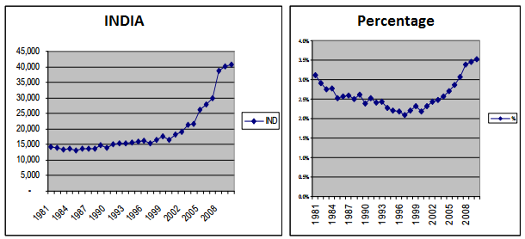
Global volume Share of Scientific publication in India
The changing trends in number and global share of scientific publications from SCI data base are presented below.

Slide 42
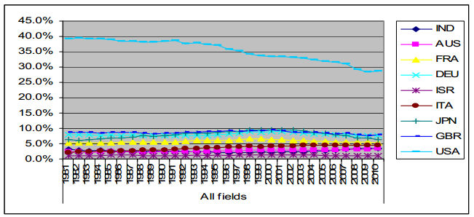
Comparisons of publication outputs relative to Developed Economies
Comparisons of Indian performance with respect to SCI publications with respect to some developed countries (Australia, France, Germany, Israel, Italy, Japan, UK and USA) in global share.

Slide 43
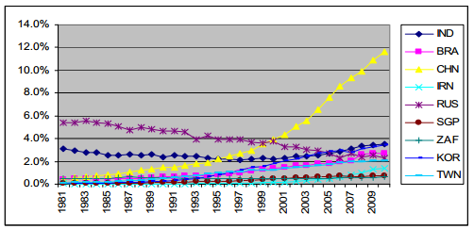
Comparisons relative to some Select Emerging Economies
Comparisons of Indian performance with respect to SCI publications with respect to some select emerging economies in global share.

Slide 44
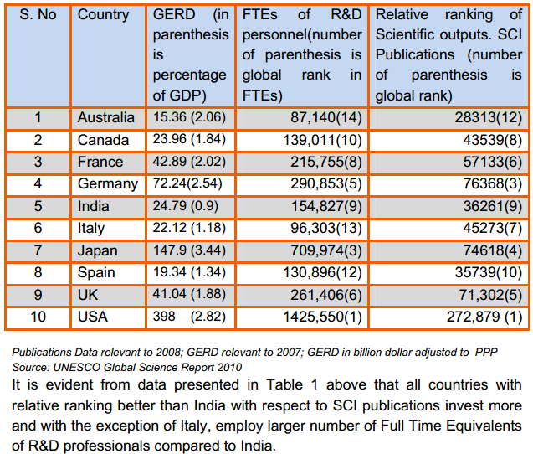
Comparison of Input-Output Relations for a select group of Nations

Slide 45
EXECUTIVE SUMMARY
 | Analysis indicate increase in Scientific outputs of 66% for 2006-10 period relative to 2011-05 period.
 | Average Growth rate is 13% per year.
 | Suggested that Chemistry, Physics, Material Sciences and Engineering technology and Clinical medicine are active areas of research where outputs are good.
 | 81% increase in number of publications in top 1% Impact making journals during 2006-10 relative to 2001-05
 | Impact factor profile indicate bimodal distribution.

Slide 46
Milestones set in STI- 2013
 | Double publication output and positioning India as top 5 in global publications output by 2020
 | Quadruple publications in top 1% journals
 | Increase the R& D personnel by at least 66%
 | Establish world class R&D infrastructure for gaining global leadership in some select frontier areas
 | Establishment of Inter University Centers
 | Participation in global R&D Centers and Big Science
 | Addressing Gender Parity

