Slide 1
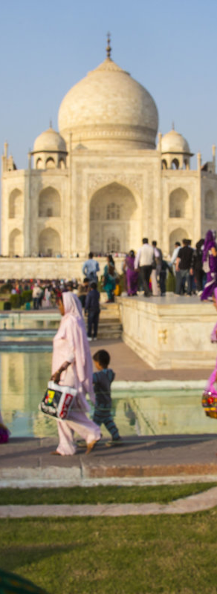
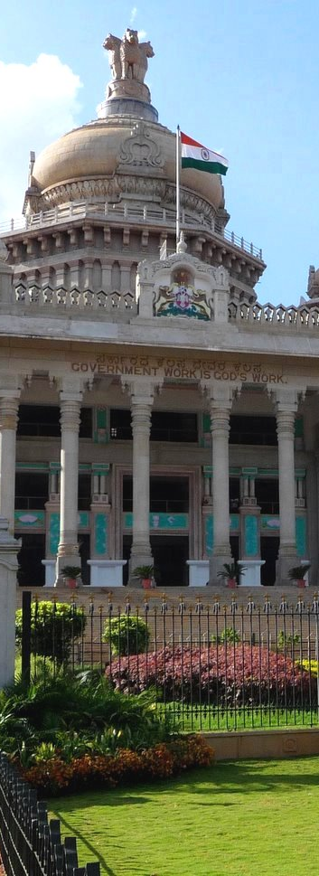
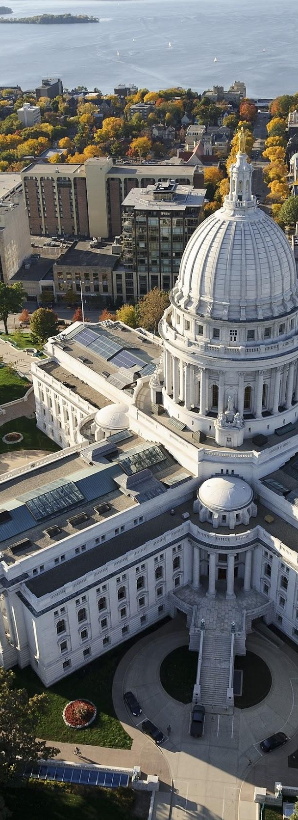


US to India Experience -
S.N. Bose Scholar 2015
Daniel Howard • May 21, 2017

Slide 2
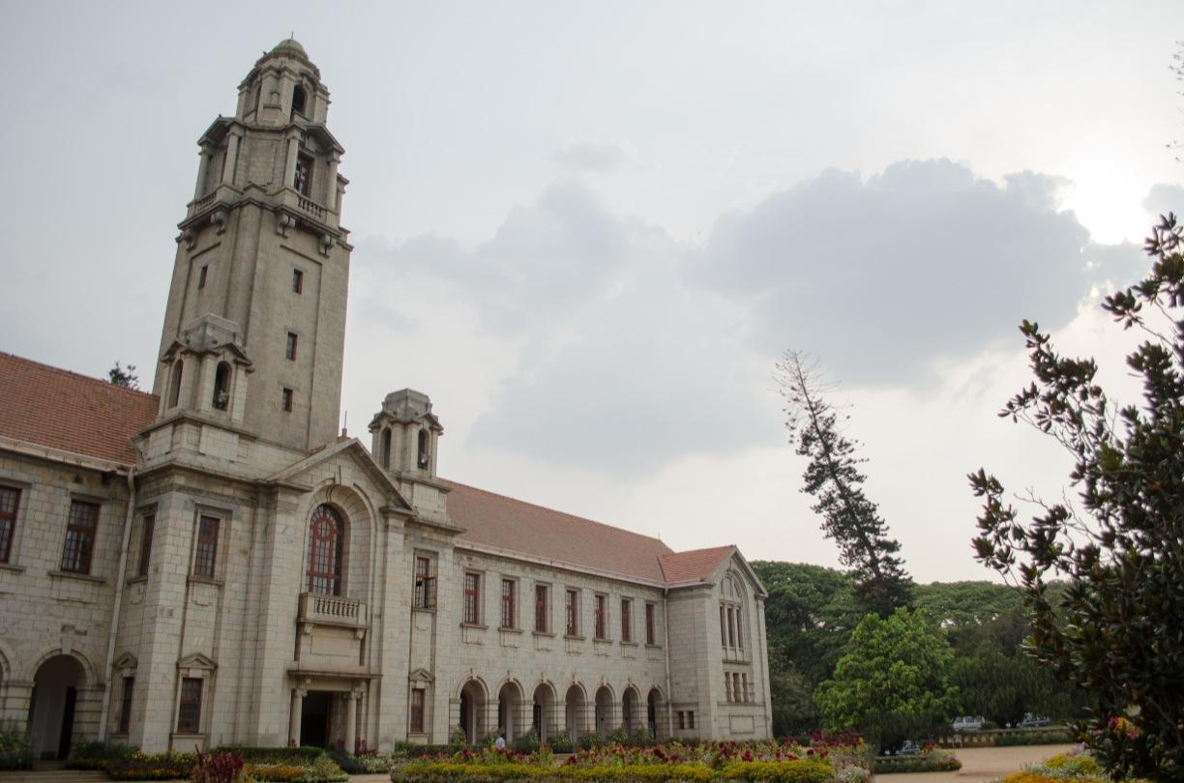
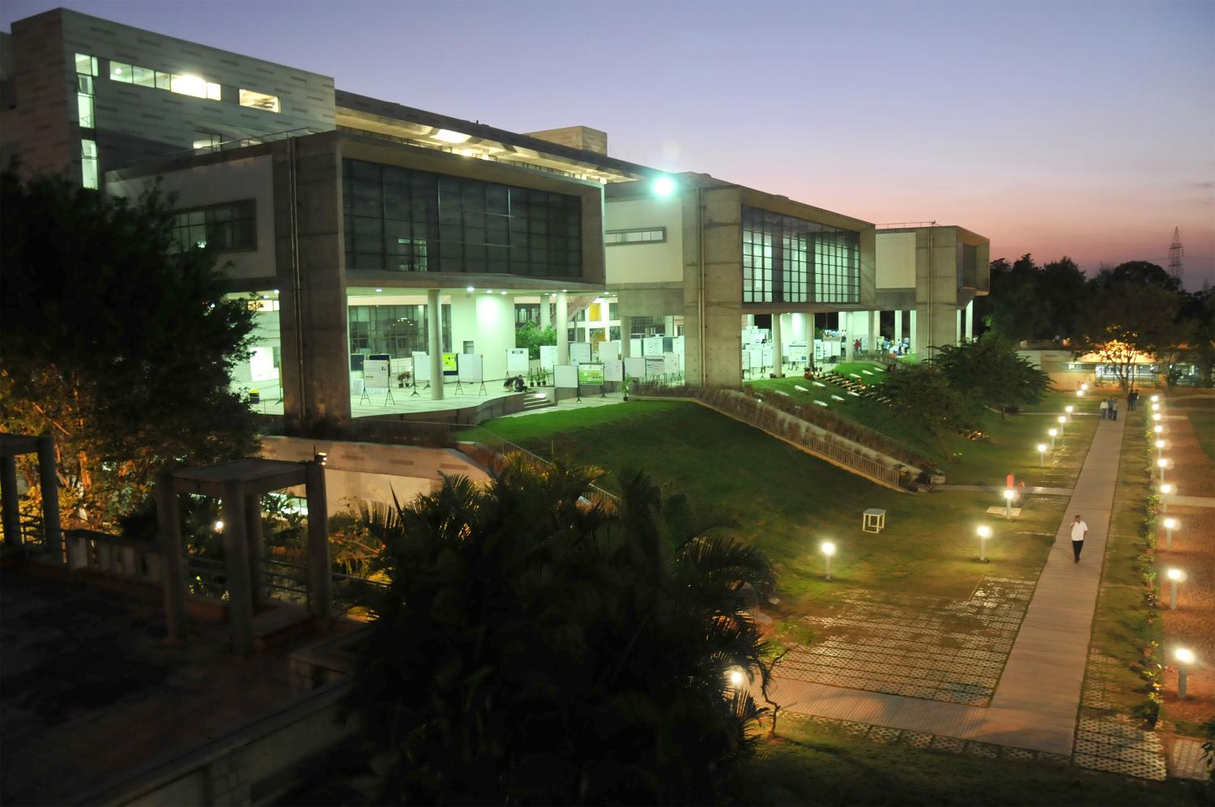
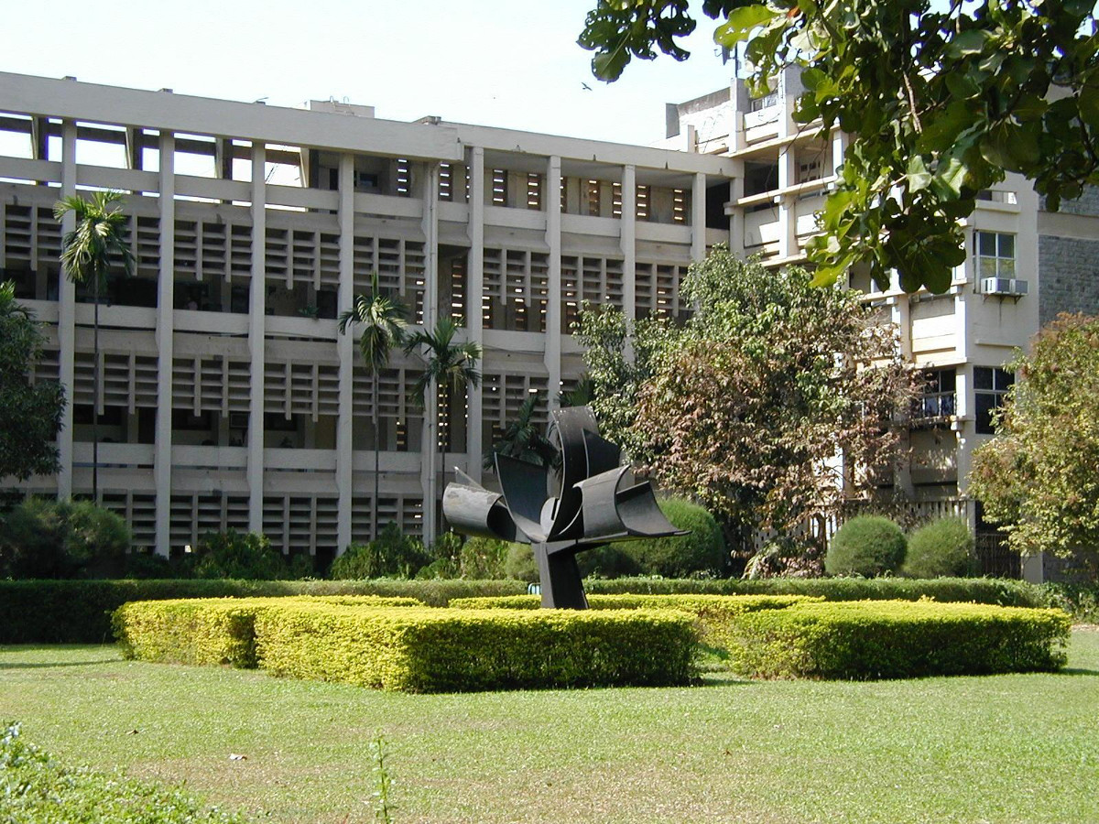
US Students in India
TIFR-Centre for Applicable Mathematics
Indian Institute of Science
National Centre for Biological Sciences
National Institute of Immunology, Delhi
IIT-Bombay
IISER-Pune
… and many others

Slide 3
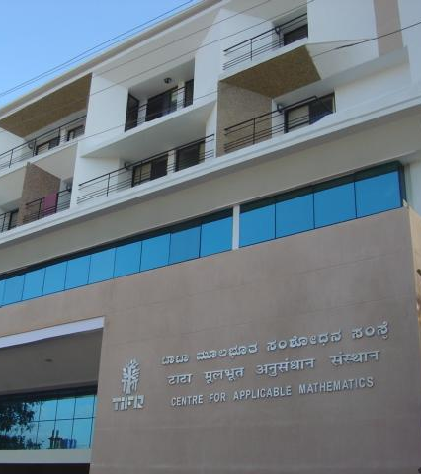

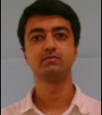
UW-Madison 2015 alumni
BS in Applied Math, Engineering & Physics (AMEP)
SN Bose Scholar
Bengaluru, TIFR-CAM
Informed my future research direction…
Praveen Chandrashekar
Computational Fluid Dynamics

Slide 4
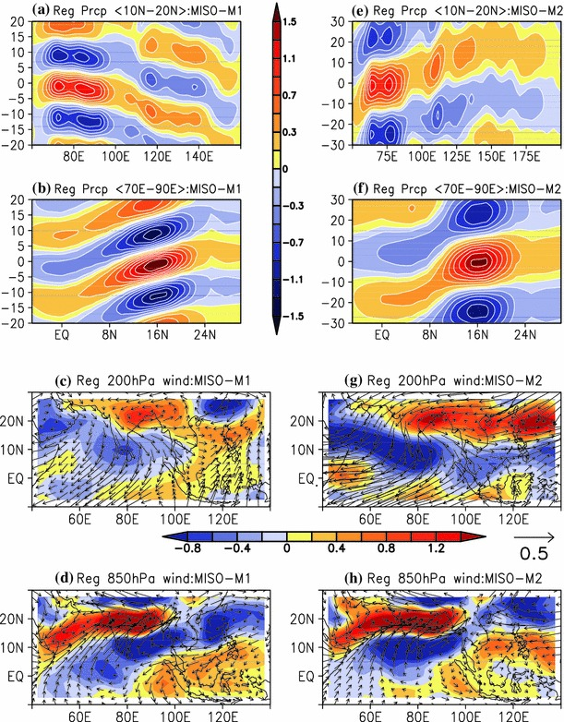
Going to India changed me...
Will apply to return to India
  Fulbright & Language Study
Motivated to be a part of the international scientific community, especially Indo-US
I solidified my research interests…
Monsoon Dynamics

Slide 5
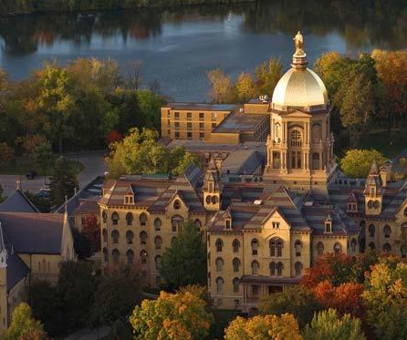
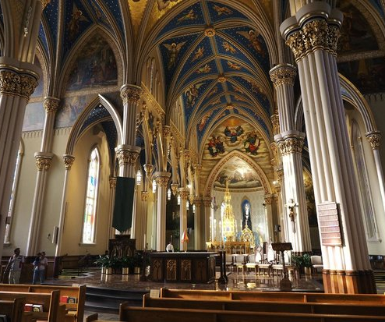
Now I study at the University of Notre Dame towards PhD
Applied & Comp. Math & Stats
Chose to work with Prof. Joe Fernando in EFD
GLOBES - Sci. Com. & Policy

Slide 6
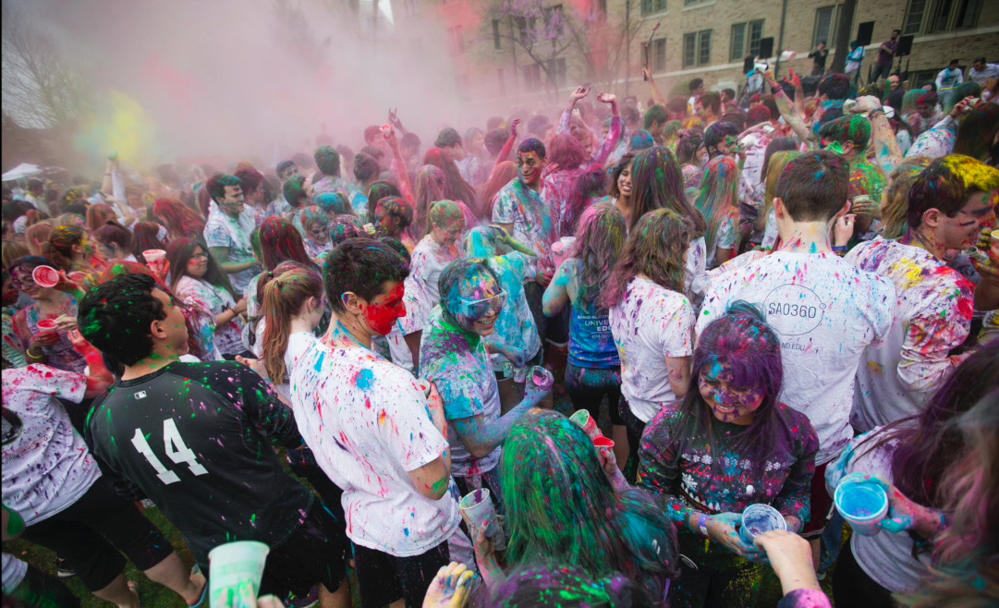
Indian culture is celebrated all over the US!

Slide 7
Wisconsin loves India too!

Slide 8
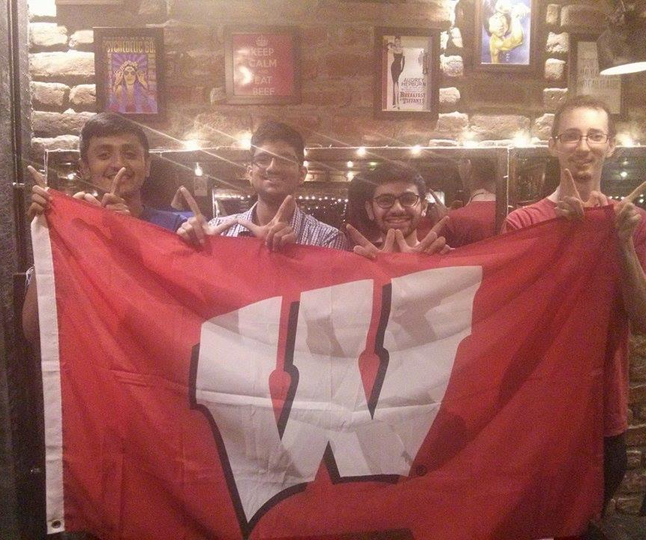
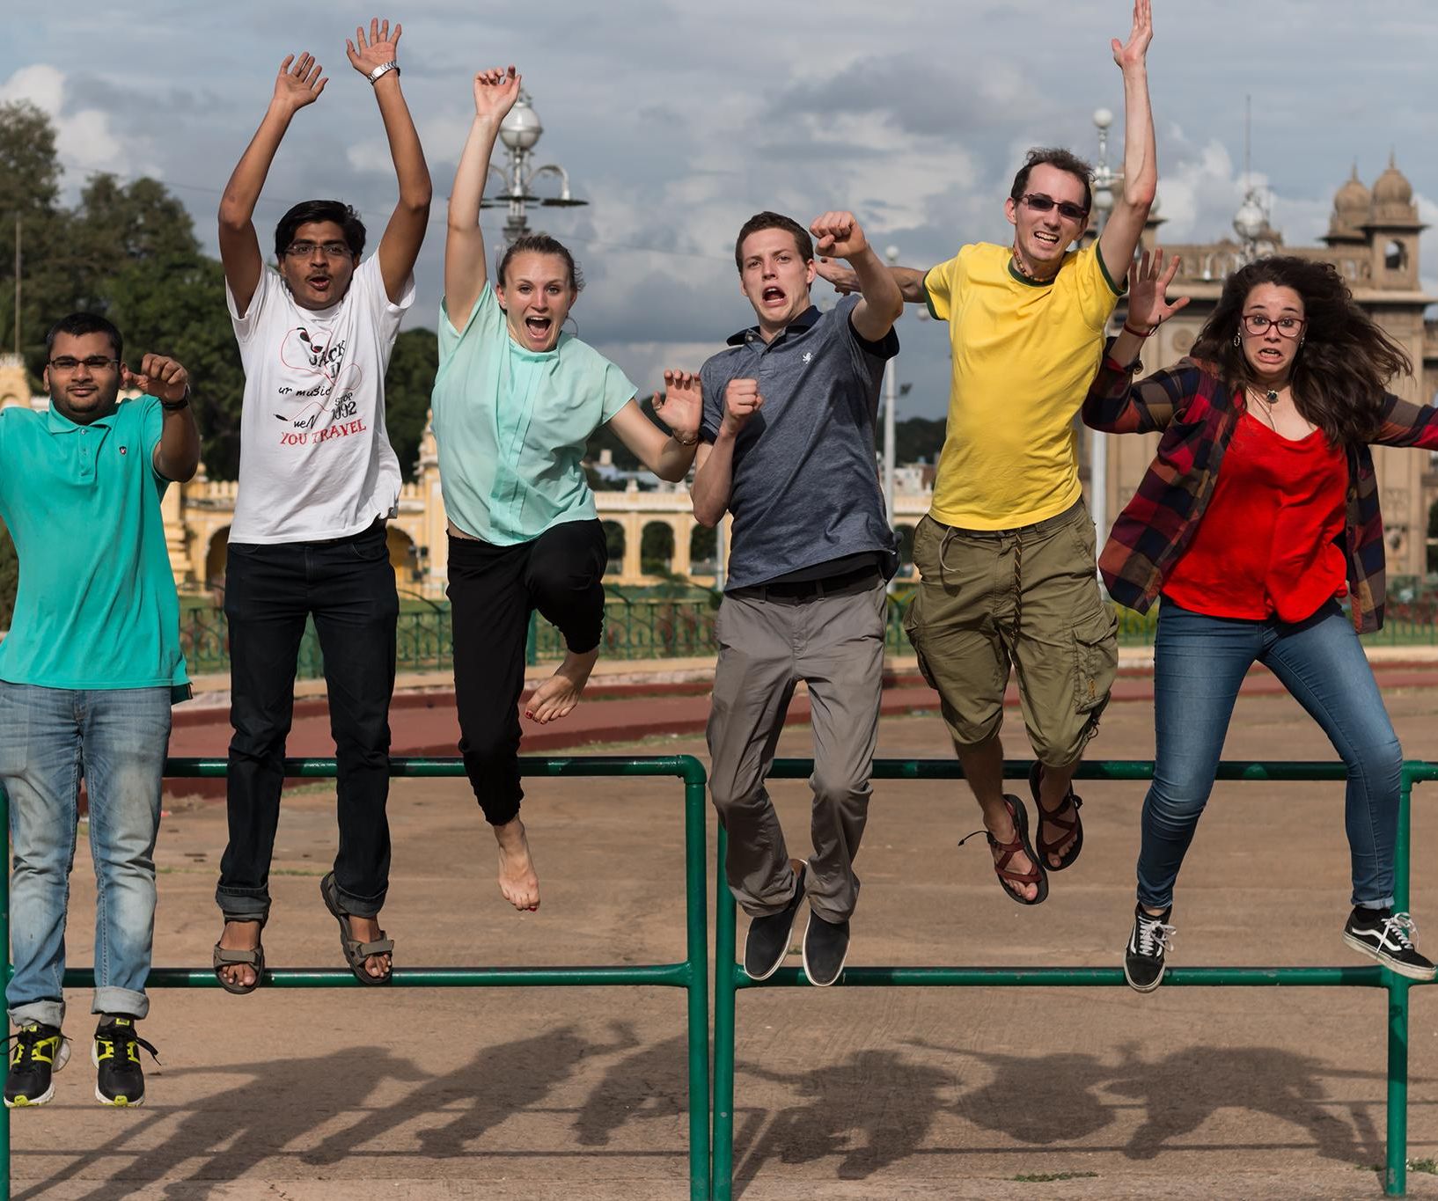

Slide 9
Encourage US Students & Scholars to Study in India
S.N. Bose Program
  http://www.snboseprogram.org/us-scholars-information-page
  Ugrad Junior/Senior or Graduate Student
  8-12 Weeks
  Studying STEM, medicine, public health, or agriculture
  Choose research project given interests
  Final version of project proposal not required at application
Fulbright U.S. Student
  http://us.fulbrightonline.org/
  BS, MS, or PhD Students
  Any Discipline
  9 Months Grant Period
  Language Proficiency not required…
  But can apply to supplemental CLEA program
Boren Scholarship/Fellowship
  https://www.borenawards.org
  Includes Language study in Madison
http://www.passporttoindia.com

Slide 10
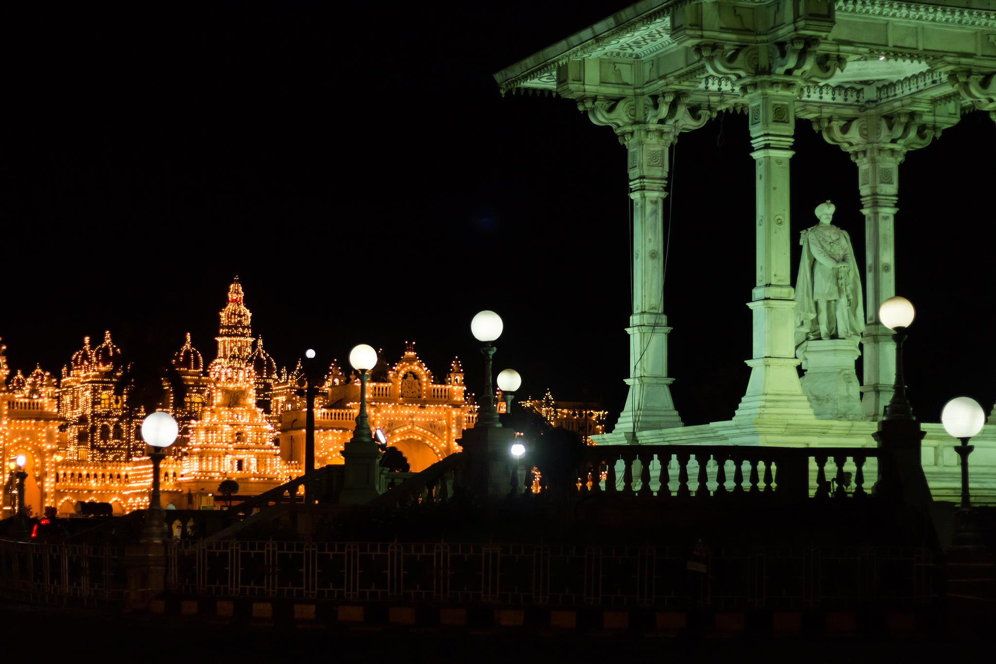
Thank you and enjoy your summer!
Questions?

