Slide 1
Welcome to University of Wisconsin Madison

Slide 2
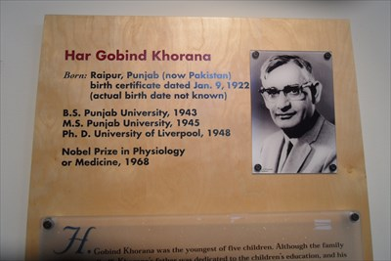
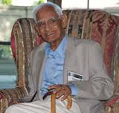
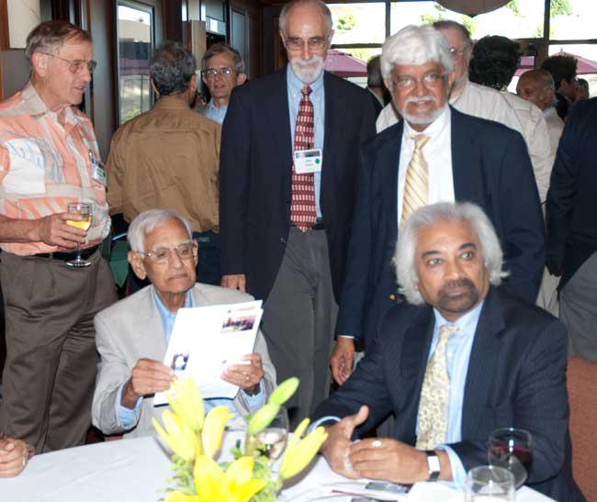
Har Gobind Singh Khorana
University of Wisconsin, Madison 1960-1970

Slide 3
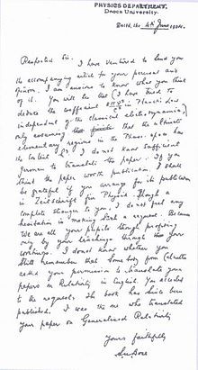
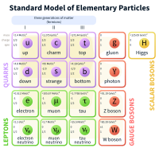
Satyendra Nath Bose

Slide 4
University of Wisconsin, Madison
Founded in 1848
$1 Billion in annual research expenditures
More than 40, 000 students
29,000 undergraduates
9,000 graduate students
Ranked 11th among public US Universities
Third largest US institutions in number of doctoral degrees awarded

Slide 5
University of Wisconsin, Madison
1944 - Joseph Erlanger (faculty) & Herbert Gasser (B.S. 1910) Physiology, Medicine: Study of the differentiated functions of individual nerve threads
1956 - John Bardeen (B.S. 1928, M.S. 1929) Physics: Discovery of the transistor effect
1958 - Joshua Lederberg (faculty) Physiology, Medicine: Genetics of bacteria
1958 - Edward Tatum (M.S. 1932, Ph.D. 1934) Physiology, Medicine: The metabolism of bacteria, yeasts and molds
1963 - E.P. Wigner (faculty) Physics: Contributions to theories of the atomic nucleus and elementary particles through the discovery and application of fundamental symmetry principles
1968 - Har Gobind Khorana (faculty) Physiology, Medicine: Gene synthesis
1972 - Stanford Moore (Ph.D. 1938) Chemistry: Research on the structure of ribonuclease, a complex protein
1972 - John Bardeen (B.S. 1928, M.S. 1929) Physics: Research on superconductivity
1975 - Howard Temin (faculty) Physiology, Medicine: Retroviruses and cancer research
1976 - Saul Bellow (M.A. x'37) Literature
1977 - John Van Vleck (A.B. 1920) Physics: Contributions to the development of electronic solid state circuitry and to theories of magnetism and conductivity
1979 - Theodore Schultz (M.S. 1928, Ph.D. 1930) Economics: Economics of developing countries
1991 - Erwin Neher (M.S. 1967) Medicine: Discovery of a method to study ion channels in cell membranes
1997 - Paul D. Boyer (M.S. 1941, Ph.D. 1943) Chemistry: Discovery of the process that makes adenosine triphosphate
1999 - Guenter Blobel (Ph.D. 1967) Medicine: Discovery of how proteins move into the correct places within a cell
2000 - Alan MacDiarmid (M.S. 1952, Ph.D. 1953) Chemistry: Discovery of polymers that conduct electricity
2000 - Jack St. Clair Kilby (M.S. 1950) Physics: Invention of integrated circuit
2007 - Oliver Smithies (faculty) Physiology, Medicine: for introducing specific gene modifications in mice using embryonic stem cells
2015 - William C. Campbell (M.A. 1954, Ph.D. 1957) Physiology, Medicine: Discovery of drug that lowers incidence of tropical diseases

Slide 6
Khorana Bose Program
Khorana program established in 2007
Expanded to include S.N. Bose program in 2012
Objectives
Provide US and Indian scholars a transformative educational and cultural experience
Engage parnters in rural development and sustainable food security
Facilitate public-private partnerships between US and India
In 2017, we have 30 Khorana scholars and 50 Bose schoalrs
2008 Khorana Scholars

Slide 7
THANK YOU.

