Slide 1
Presenter:
Piyush Behari Lal, PhD
Post Doc, Dr. Patricia Kiley’s Lab
Wisconsin Energy Institute, GLBRC,
University of Wisconsin - Madison
On Behalf of
Sci-ROI Organizing Committee

Slide 2
Sci-ROI
Not-for-profit volunteer-run organization.
Runs under auspices of WINStep Forward.
Sci-ROI was commenced in 2015 by
Dr. Sriram and
Prof. Aseem Ansari.
And, it was successfully co-founded by
Dr. Ashwin Mohan (Washington Univ.),
Dr. Sumitha Nallu (Univ. of Chicago),
Dr. Megha Rajendran (Purdue Univ) and
Dr. Anshuman Kumar Srivastava (MIT).

Slide 3
Need for Sci-ROI
Indian Population: 1.3 Billion
46% are below 19 yrs of age
Immediate need for
Educational
institute
Startup/Job/
Entrepreneurs
Funding
Policy Makers
Postdocs & Scientists
(Potential Faculty Candidates)
Collaborators
Entrepreneurs

Slide 4
Objective
Explore career opportunities in India and the USA.
Facilitate interaction.
Promote innovation through supporting entrepreneurship and collaborative research.
Influence relevant policy issues, e.g., technology transfer.
Increase awareness of direct and indirect collaborative initiatives between India and USA.

Slide 5
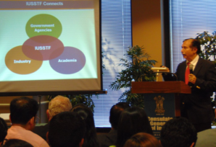
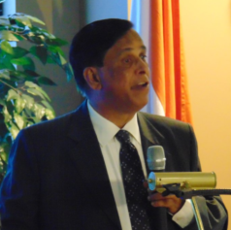
Launch of Sci-ROI
Sci-ROI was launched by the then Consul General of India Dr. Ausaf Sayeed and WINStep FORWARD at the Consulate General of India, Chicago in May 2015.
Dr. Rajiv Sharma, Then Executive Director, Indo-US Science and Technology Forum (IUSSTF)
Prof. T. K. Chandrashekar, Secretary, Science and Engineering Research Board (SERB), Govt. of India

Slide 6
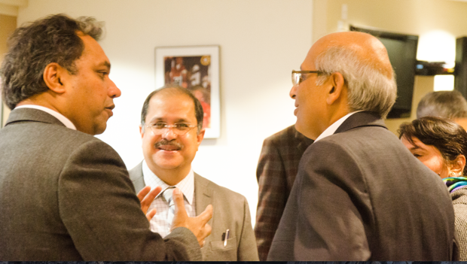
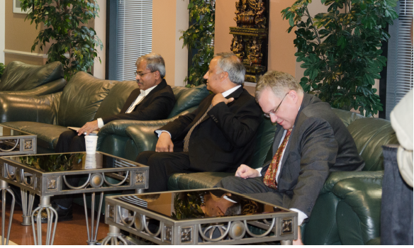
Sci-ROI annual meeting: YIM-C
Launched by Consulate General of India, Chicago, WINStep Forward and Sci-ROI on Oct 21, 2016.
First of it’s kind in the world; Multidisciplinary.
Bridges academic and entrepreneurial talent.
Prof. Aseem with CG Dr. Ausaf Sayeed and Dr. Shahid Jameel, CEO, Wellcome DBT India Alliance.
Dr. Brakaspathy, Secretary, SERB; Dr. Shekhar Mishra, Scientist, Fermi Lab; Mr. Jonathan Ward, Principal Commercial Officer, CG –USA, Kolkata.

Slide 7
First annual meeting: YIM-C 2016 www.winstepforward.org/yimC2016
Panel taking querries of participants at one of the session.
Enthusiastic crowd from different fields of research.
Notes:
Attended by more than 150 students and post docs from across USA
More than 25 delegates from India and USA
Dr. Brakaspathy, Secretary, Science and Engineering Research Board (SERB), Govt. of India
Dr. Shahid Jameel, CEO, Wellcome-DBT India Alliance
Representatives from academia
(India) IIT, IISc Bangalore, JNCASR, THSTI and other leading research institutes in India
(USA) Purdue, Kellogs, National Lab, NSF
Representatives from Industry and Entrepreneurs
(India) Pfizer India, InStem etc.
(USA) InNow, Fermi Labs etc.

Slide 8
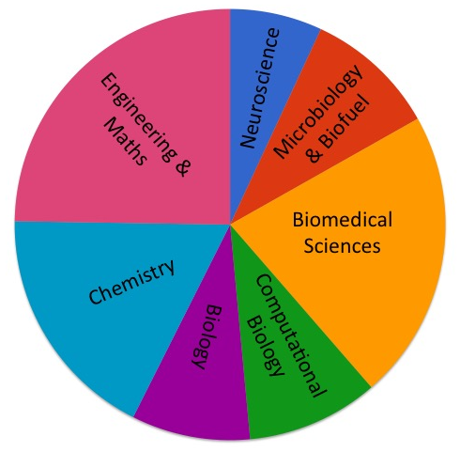
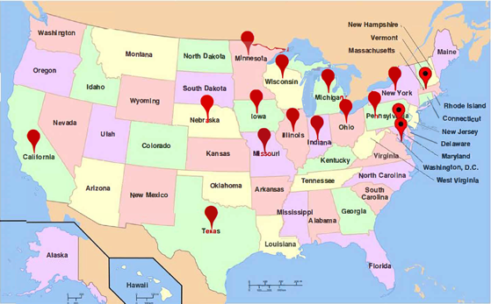
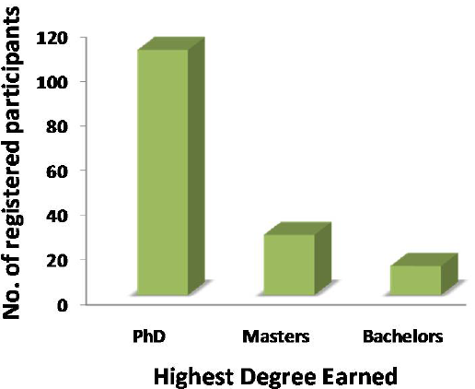
Participants of YIM-C 2016 www.winstepforward.org/yimC2016

Slide 9
YIM-C 2016 Event Structure
Session 1: Indo-US Partnership: Science and Technology
Session 1: Research and Funding Opportunities in India
Session 2: Emerging Trends - Institutional Perspectives Part I
Session 3: Emerging Trends - Institutional Perspectives Part II
Session 4: Innovation landscape (I) - Make in India / Entrepreneurship / US-India ventures
Session 5: Careers in India
Session 6: Innovation landscape (II) - Make in India / US-India entrepreneurial ventures

Slide 10
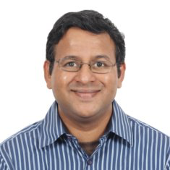
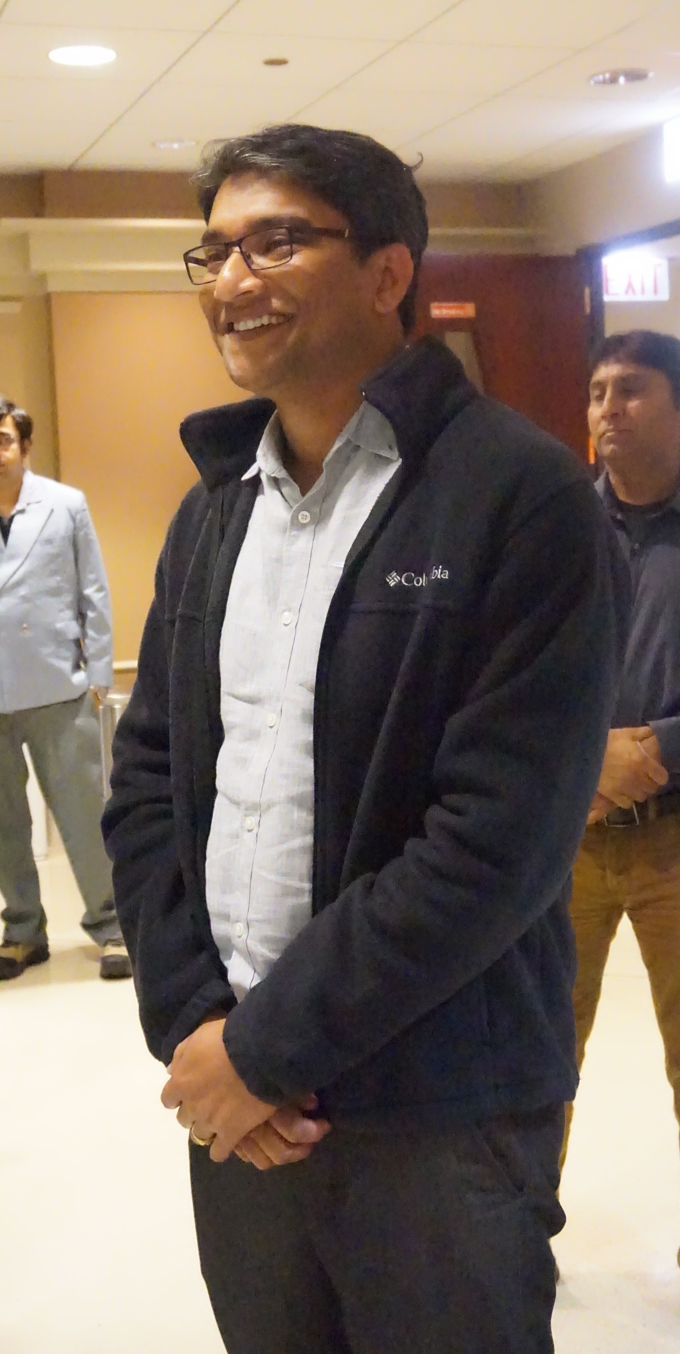
Few accomplishments
Dr. Sriram, Assistant Prof.
Ajim Premji University
Dr. Renu Singh, Scientist at CFTRI,
Dr. Arindam Mondal,
Assistant Prof. IIT-Kharagpur
Dr. Devesh Bhimsaria

Slide 11
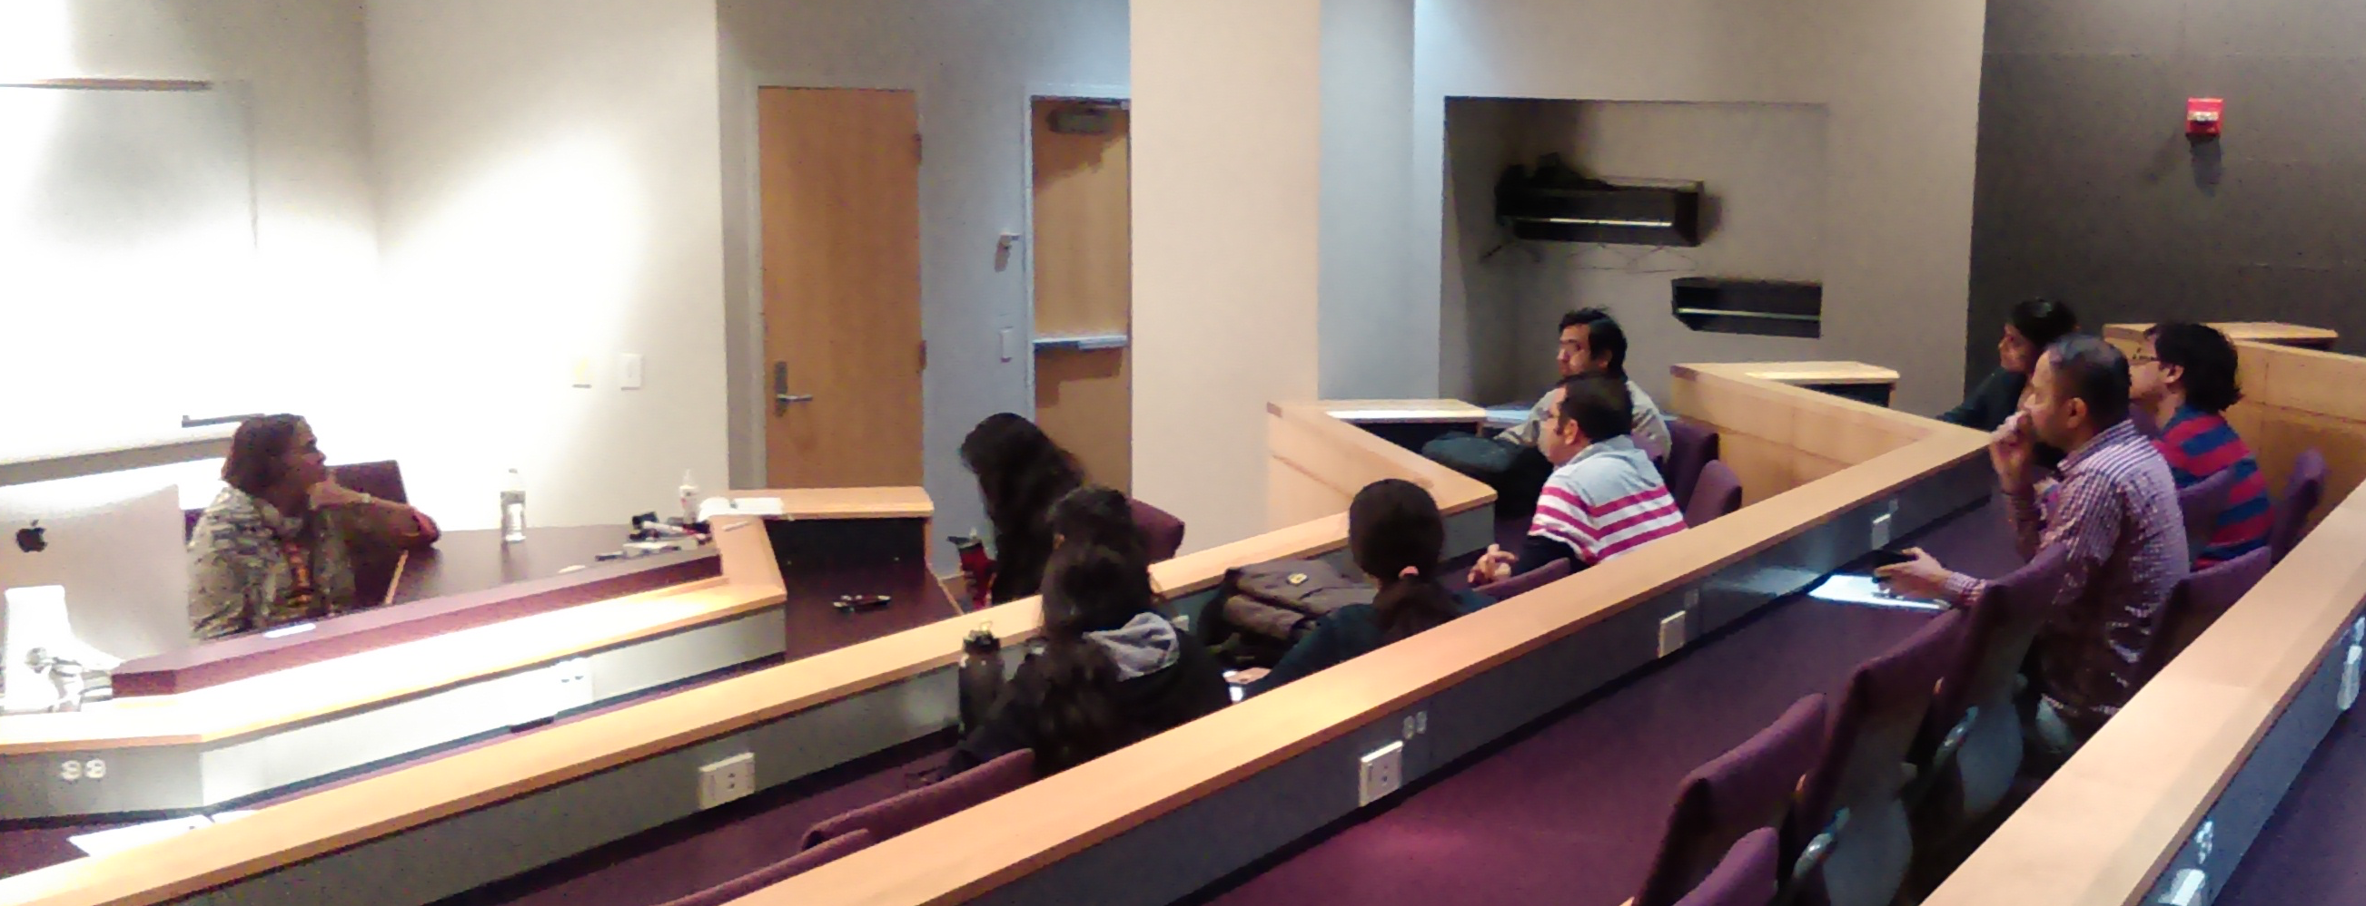
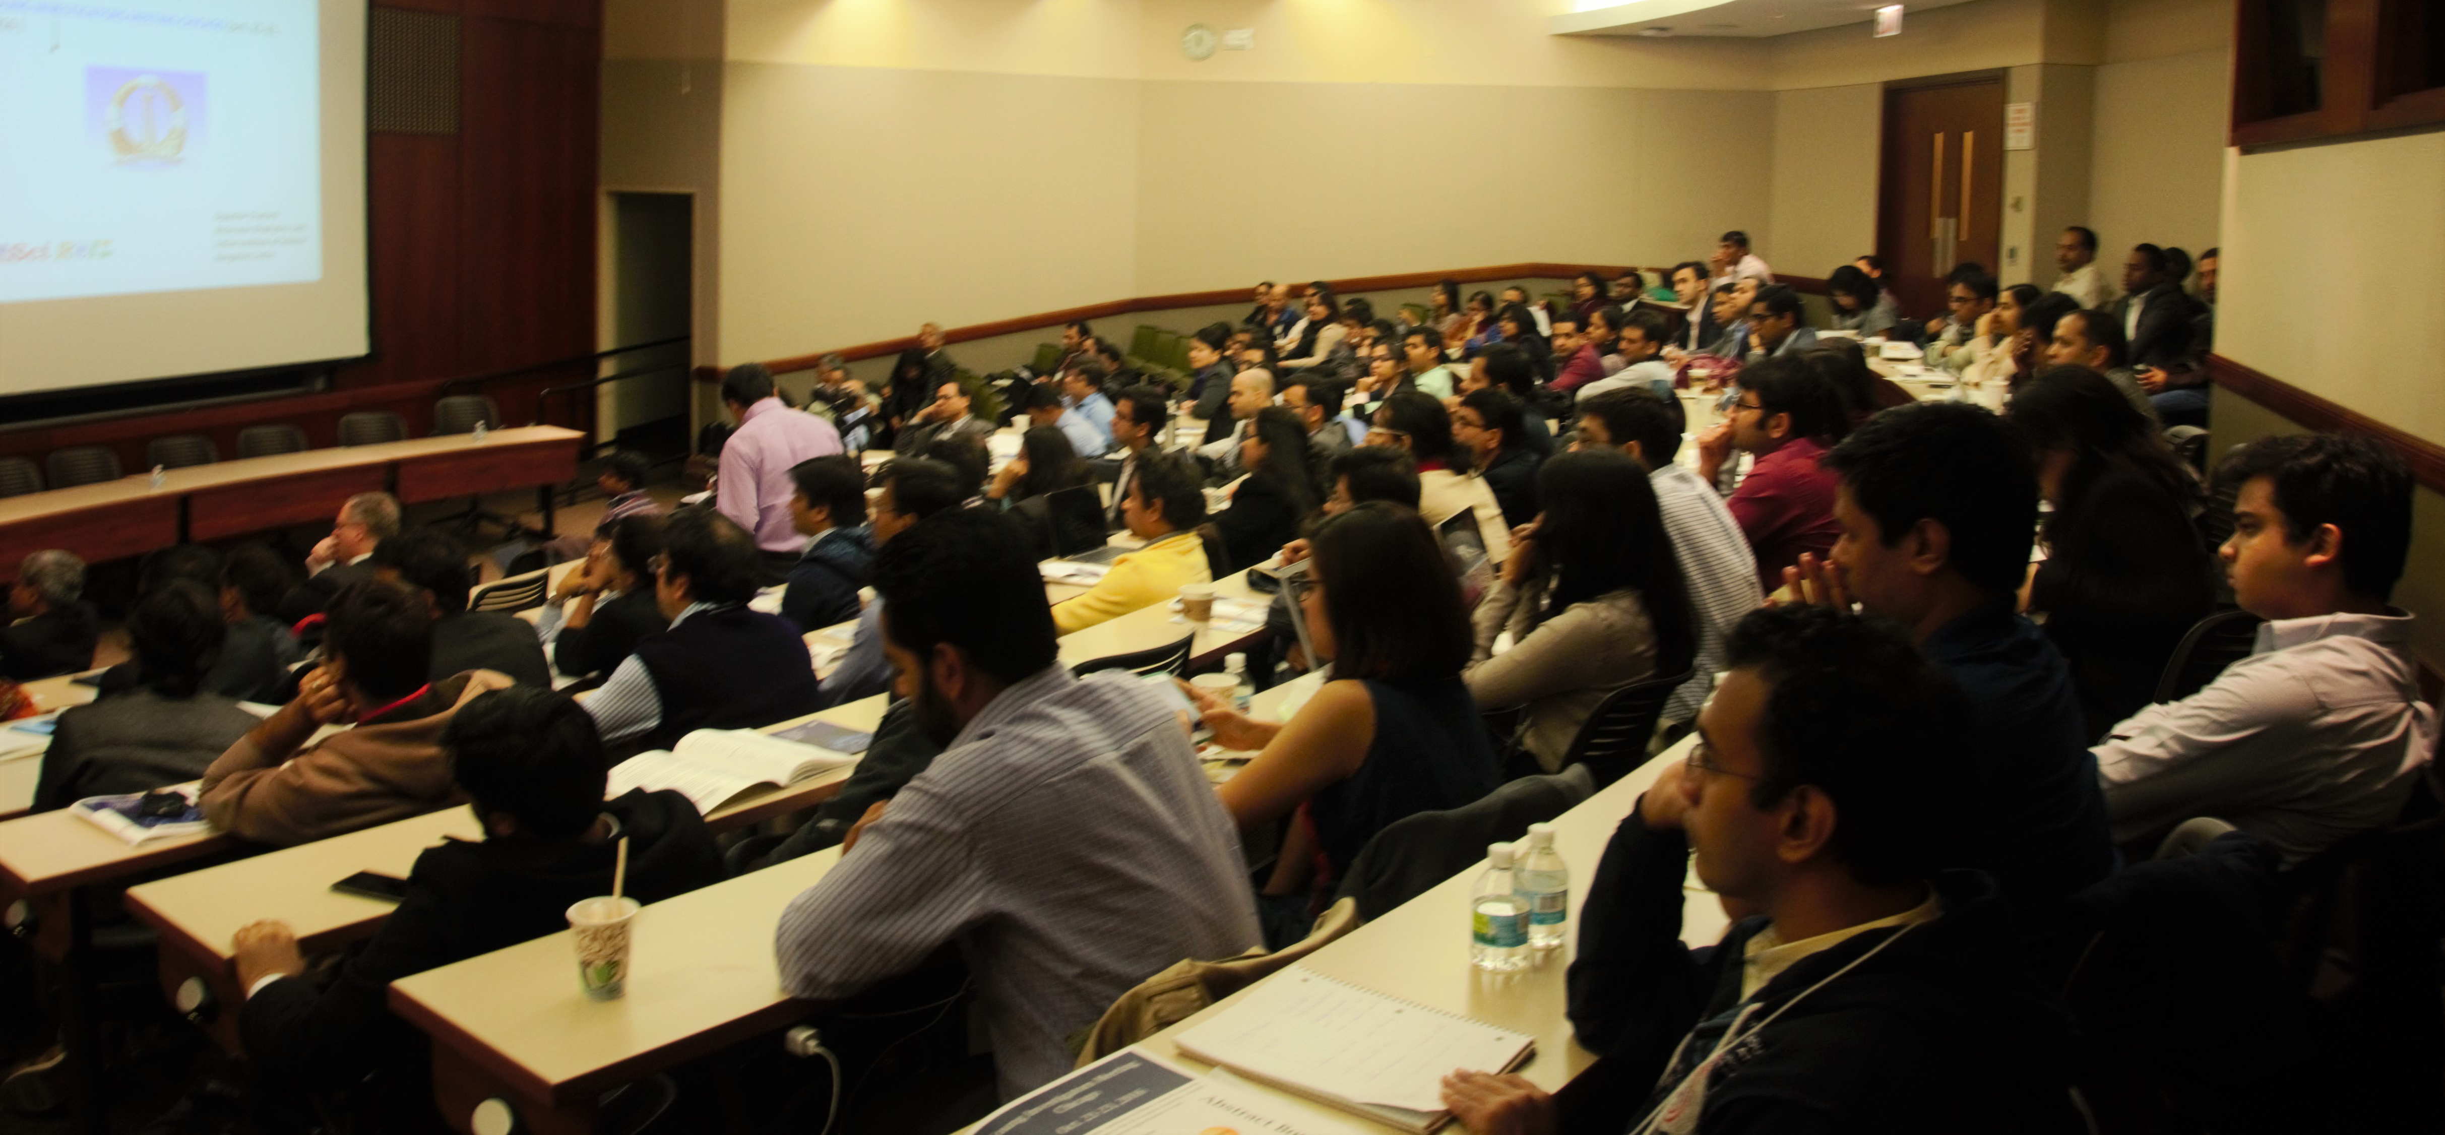
So far, Sci-ROI has successfully executed several meetings at Madison and Chicago
Meetings at UW-Madison in 2016
Annual Meeting 2016
Prof. Manju Bansal from IISc, Bangalore interacting with UW-students and Postdocs.
Other Meetings with:
Prof. Deepankar Chaterji, IISc, Bangalore,
Prof. Sidharth Ray, Bose Insititue, Kolkata,
Prof. J. Gowrishankar, CDFD, Hyderabad,
Prof. Tapas Kundu, JNCASR, Bangalore.
Young Investigators Meting- Chicago (YIM-C) 2016
(Participation at maximum of its capacity)

Slide 12
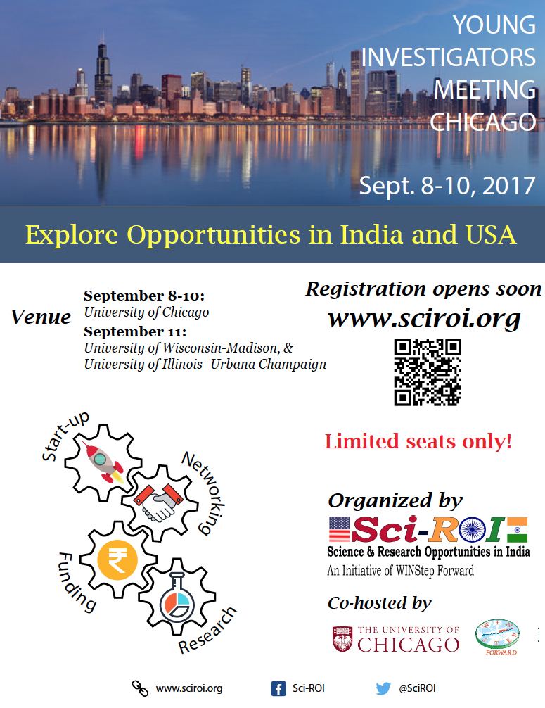
Young Investigaotrs Meeeting - Chicago (YIM-C) 2017
Expected delegation from India
Leading policy makers.
Leading scientists and representatives from academia.
Industry/Entrepreneurs.

Slide 13
Future

Slide 14
Sci-ROI Team
Mentor
Prof. Aseem Ansari
Prof. L. S. Shashidhara, Vice President, INSA,
WINStep Forward
Current Members
Ms. Shachi Mittal (UI- UC)
Ms. Nidhi Kakkar (UI- UC)
Dr. Jaspal Singh (UT- Southwestern)
Dr. Ratika Kunder (Northwestern University)
Dr. Amitabha Mukhopadhyay ( Univ. of Chicago)
Mr. Shreyas Chavan (UI- UC)
Mr. Krishna Anapindi (UI- UC)
Dr. Mayur Kajla (UW- Madison)
Aayushi, Rajesh, Charu, Asfa, Ashraf, Arun, Hamid, and….
Past Members
Dr. Ashwin Mohan (Washington Univ.),
Dr. Sumitha Nallu (Univ. of Chicago),
Dr. Megha Rajendran (Purdue Univ.),
Dr. Anshuman Srivastava (MIT),
Dr. Arindam Mondal (UW- Madison; Now, IIT-Kgp),
Dr. Renu Singh (Univ. of Minnesota; Now at CFTRI),
Dr. Ashish (UW- Madison)

Slide 15
Think Beyond the limit
Best of Luck
Help Others
Get helped
Be in the Know

