Slide 1
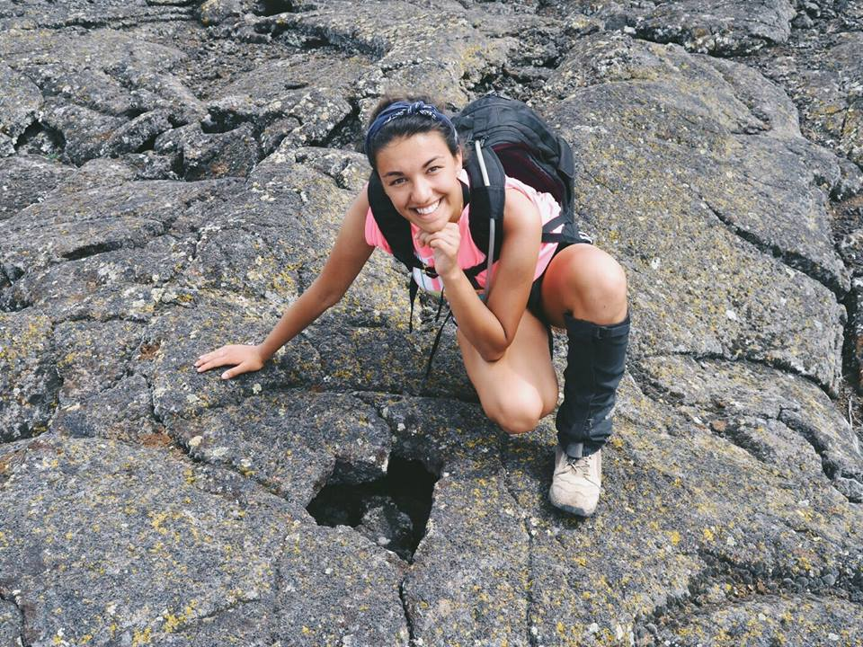
Chanel Vidal Geology major Iowa State University Expected graduation date: May 2021
Next goal: study planetary geology in grad school
End goal: work for NASA as a planetary geologist

Slide 2
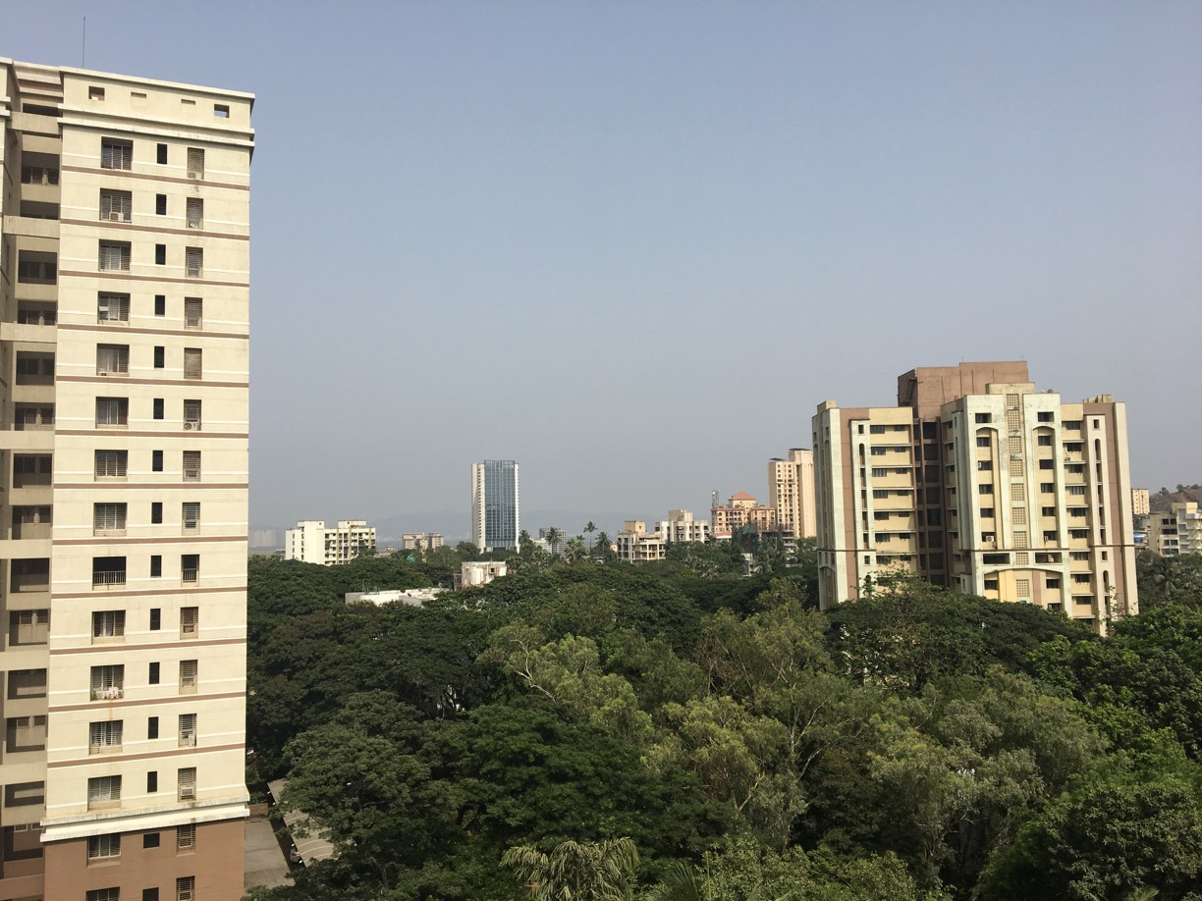
Why I applied for Bose
Boson particle
Oppurtinity to learn from scientists in India while furthering my geology experience
Becoming a Bose scholar became a huge goal
So thankful!

Slide 3
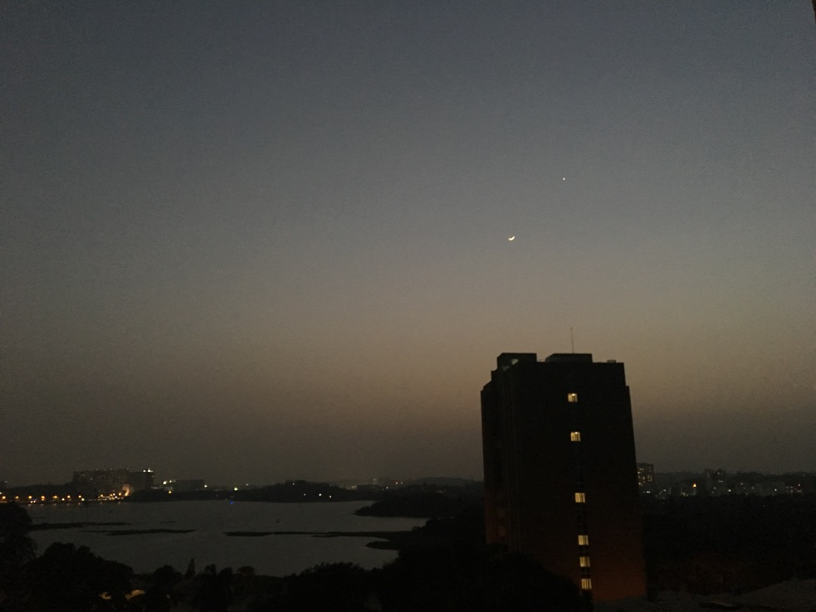
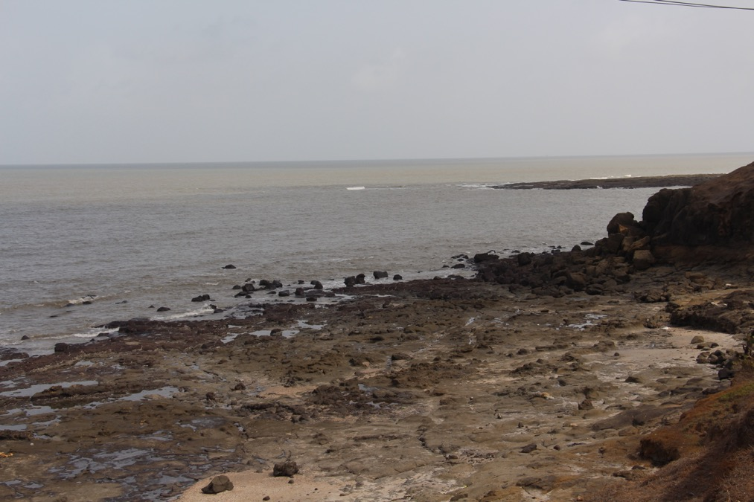
Then what?
Emailed geology departments in Mumbai
IIT studies Deccan Basalts
I was nervous, but beyond ready…

Slide 4
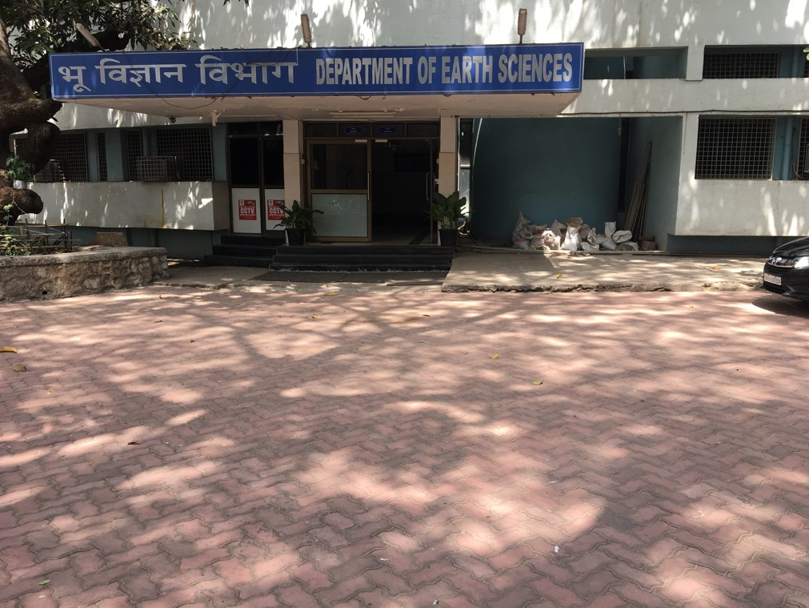
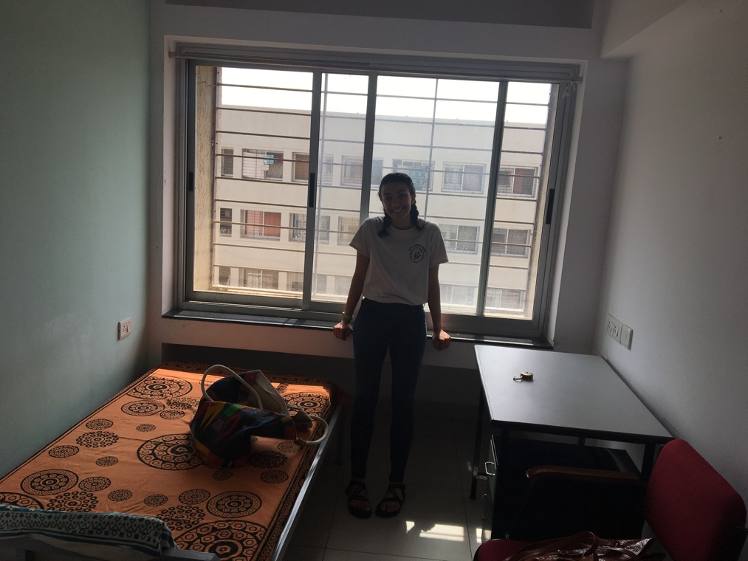
Indian Institute of Technology, Bombay
Prof. Soumyajit Mukherjee
Geodynamics Lab in Department of Earth Sciences

Slide 5
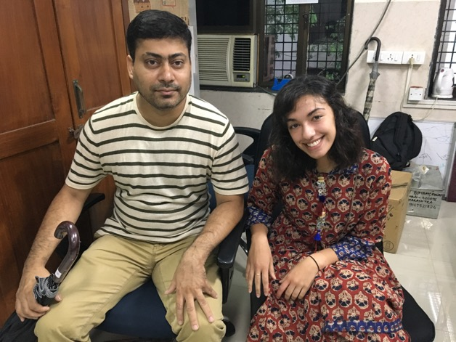
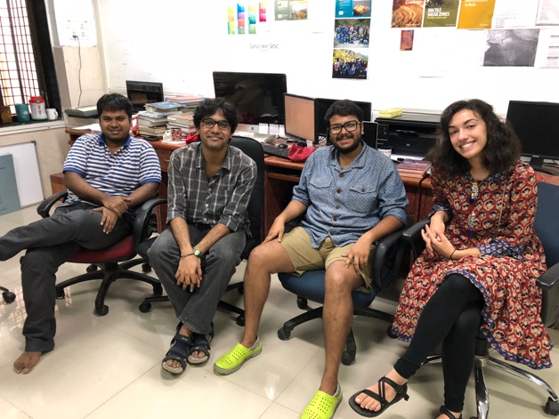
Prof. Soumyajit Mukherjee
Assessment of knowledge
His goals for me:
Field work
Reading
Basics of structural geology
1:1 lectures
Best parts of working for him:
Became a part of his geology lab
PhD students
Notes:
through presentation; based on that he developed curriculum especially for me to take the most out of my time there
of graduate level courses; condensed them and modified them to meet my educational needs

Slide 6
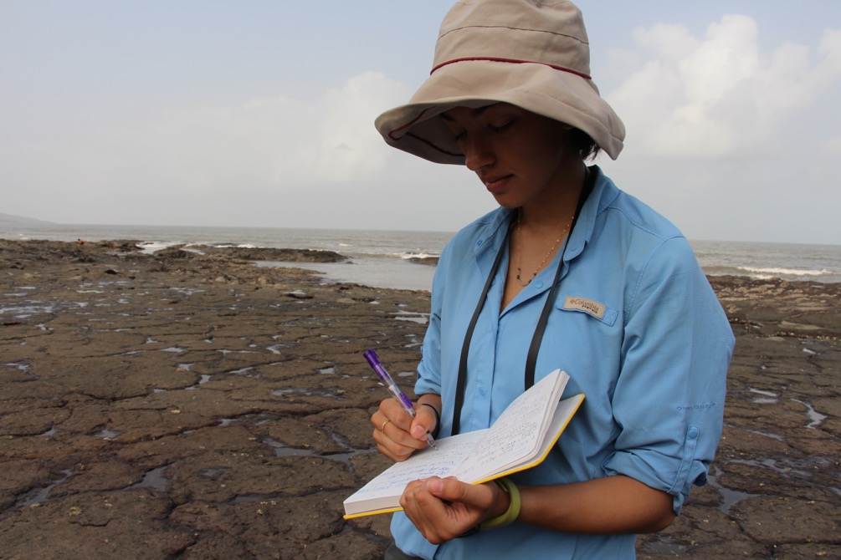
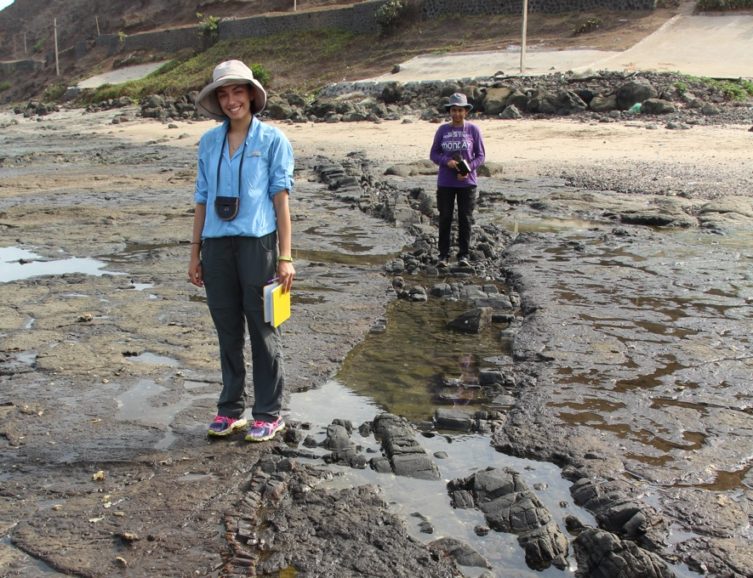
Field work
Identify brittle shear zones in Deccan Basalts
Beaches in and around Kashid
How to take field notes
How to learn in the field
How to see with a structural geology lens

Slide 7
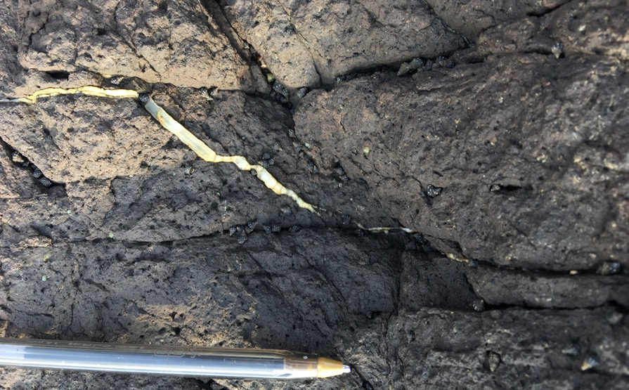
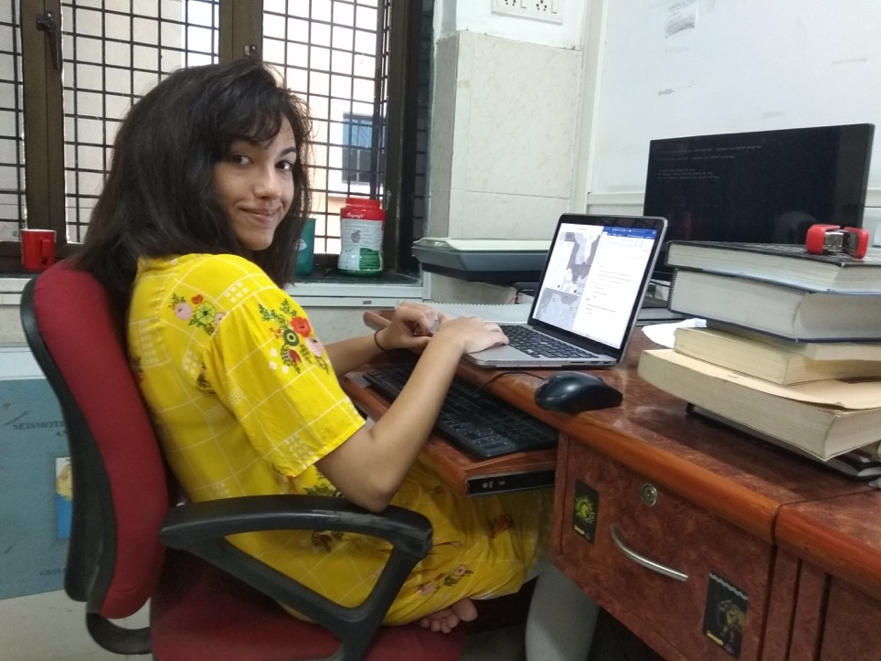
Scientific reading & writing
Read scientific papers and books
Wrote a report on each reading
Learned how to write scientifically
Learned how to annotate and read scientific papers
How to ask questions

Slide 8
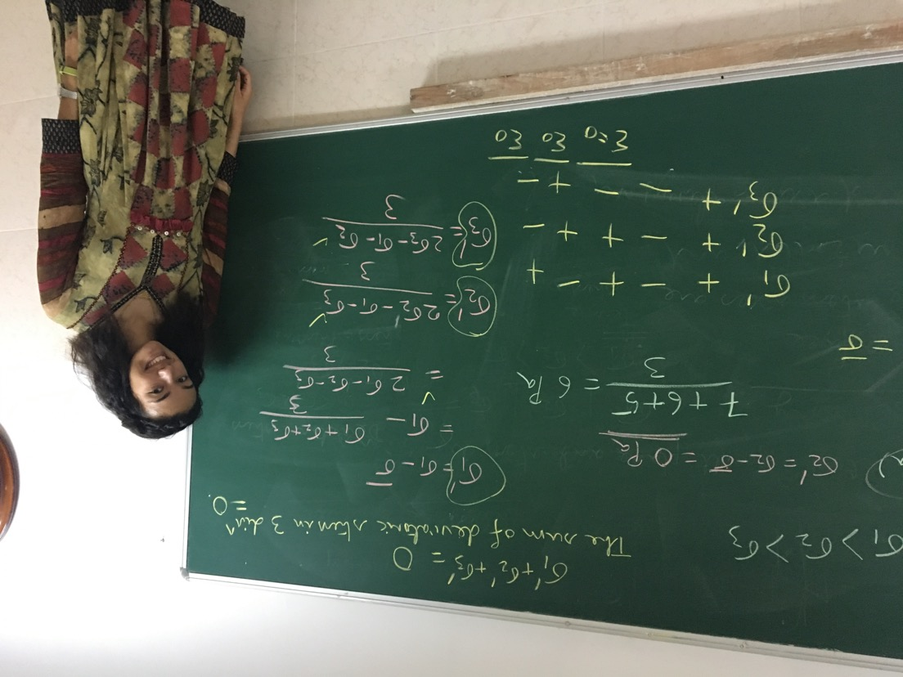
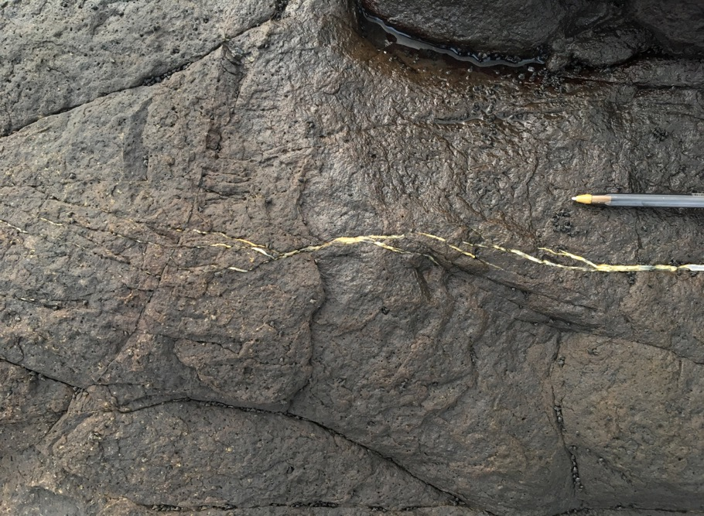
1:1 instruction
Lectures from Prof. S. Mukherjee
Learned from PhD students
Basics of structural geology
How to take notes
How to think in a lecture
How to absorb information efficiently

Slide 9
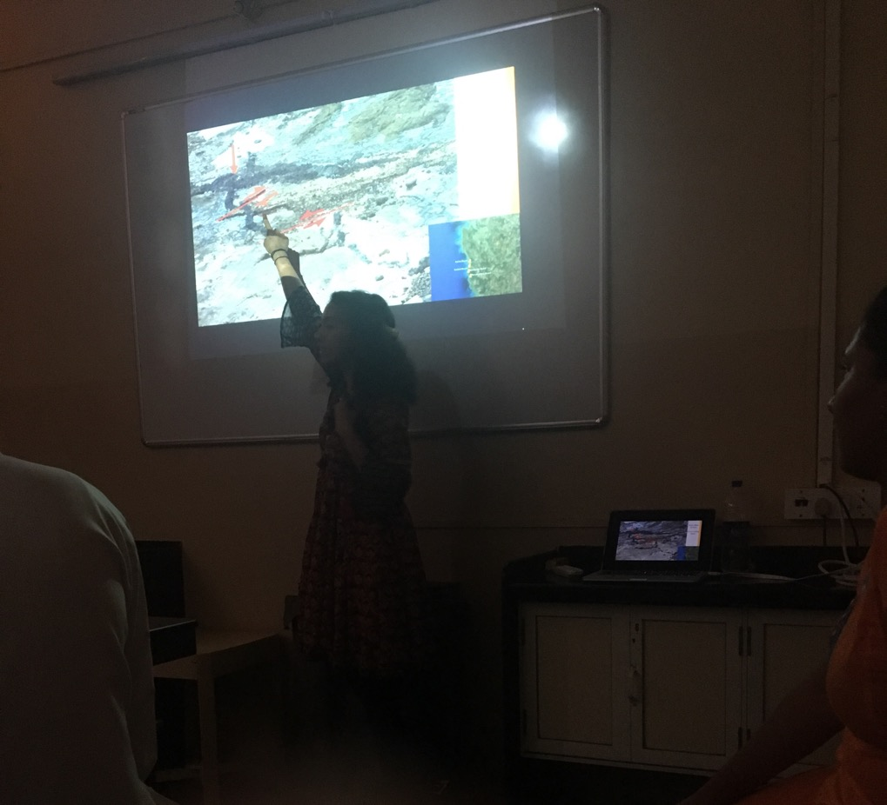
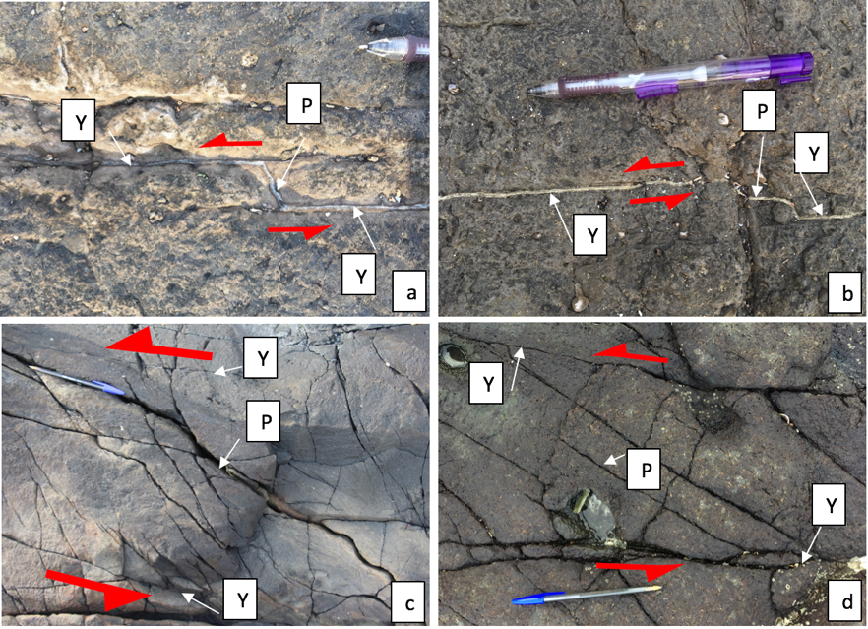
Presenting skills
Prepared scientific presentations
St. Xavier’s College
Canary Islands presentation
How to annotate figures
How to talk to an audience of scientists

Slide 10
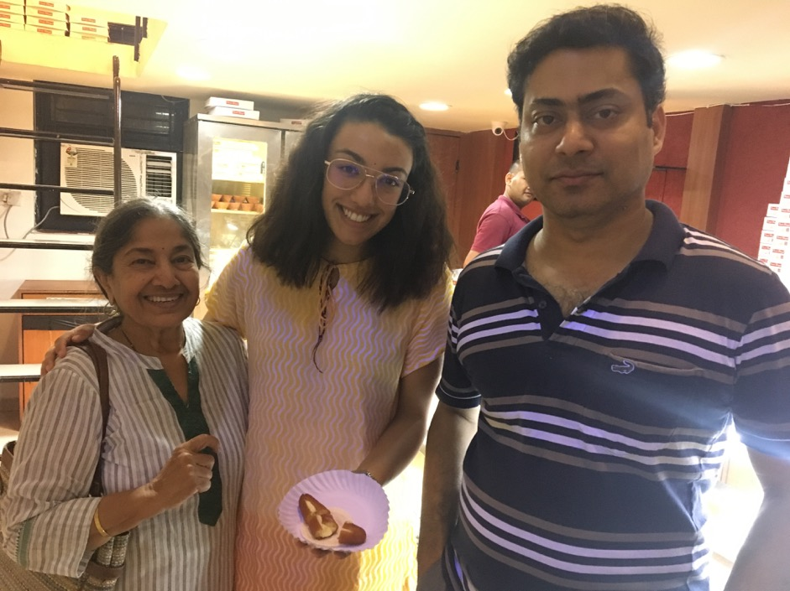
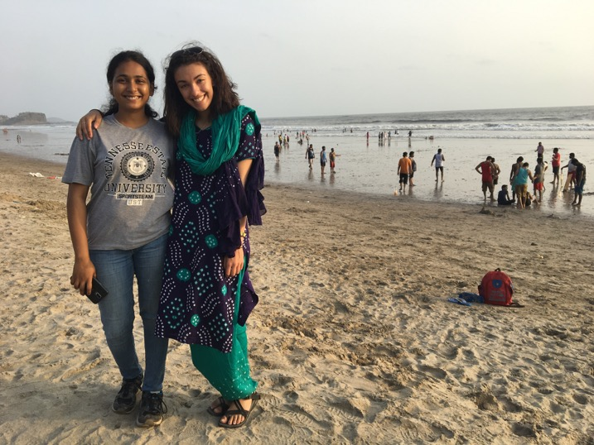
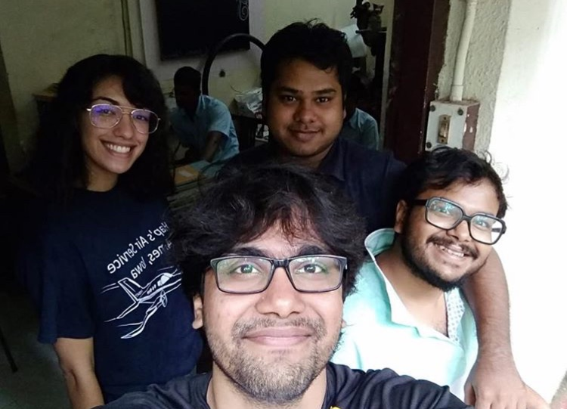
How Bose and Prof. S. Mukherjee made it an amazing experience:
Made new friends who immersed me in Indian culture
Detol and Durga statue
Ensured safety and a healthy mind
Notes:
and indulged mein cultural activities
Gong out for ice cream, gong out for tea, trying Indian sweets

Slide 11
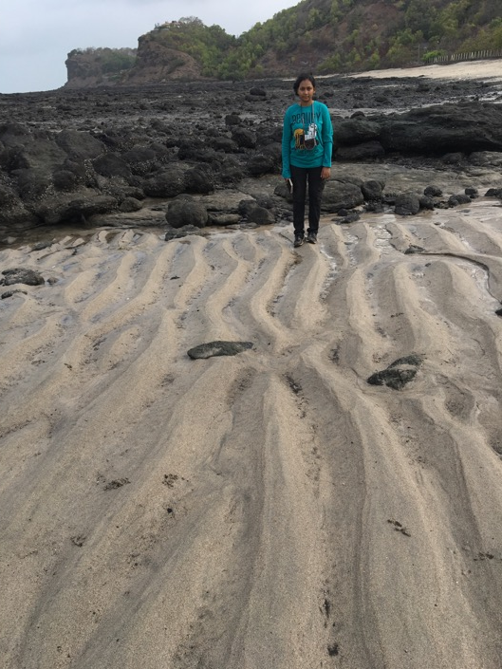
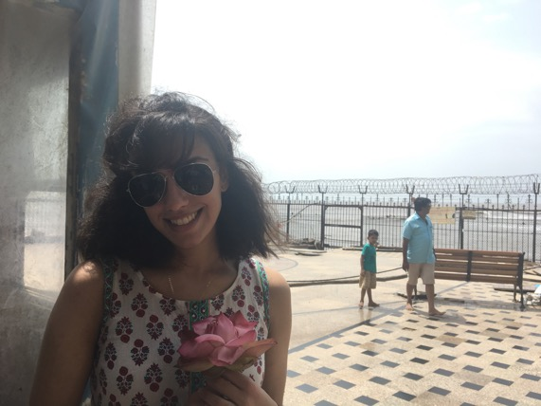
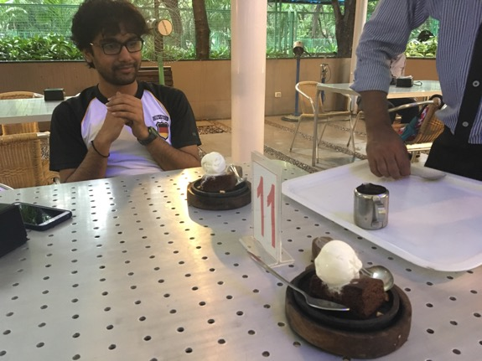
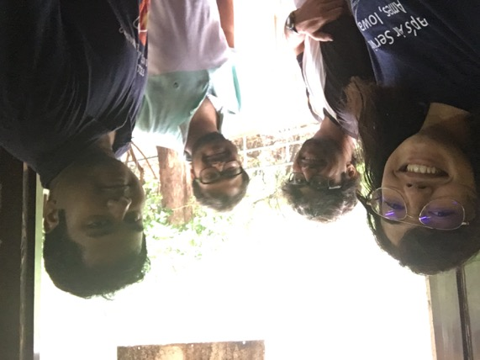
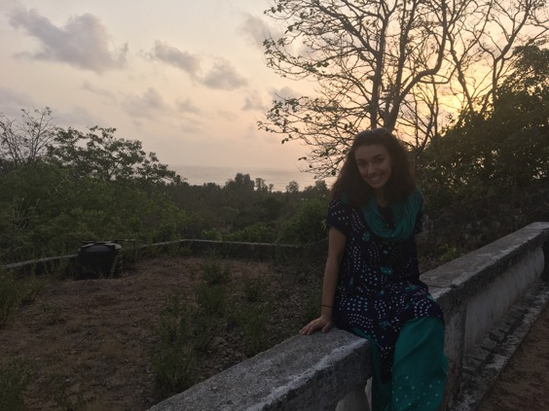
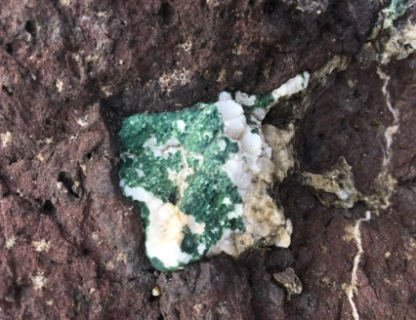
Was it worth it?
Challenges I faced:
Heat exhaustion
Being 18 in a foreign country
Time difference from everyone I knew
Oh yeah.

Slide 12
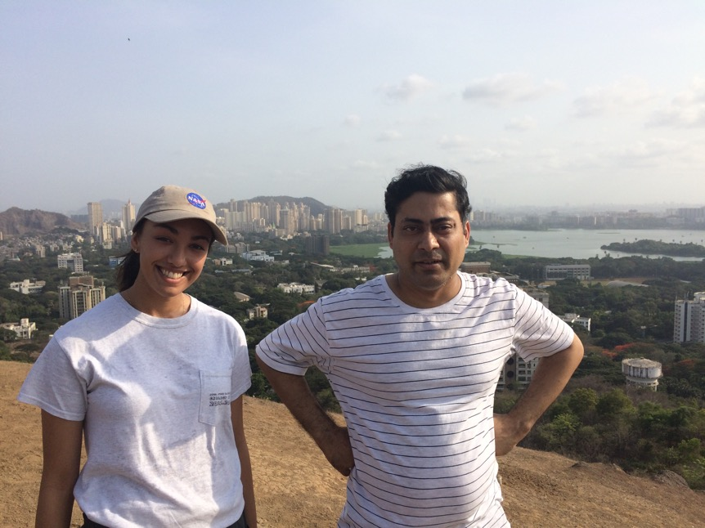
Thank you Bose scholarship
Without this team, this would’ve been impossible…
Prof. S. Mukherjee for accepting an undergraduate student
Oppurtinity to find my place in Indian culture and geology

