Slide 1
Utilizing a multiplexing approach to understand the molecular mechanisms of astrogliosis
Bhagyashri Pandey, S.N. Bose Scholar
Asmita Jaiswal, pHD Student
Dr. Naren Ramanan, Principal Investigator
Notes:
Hello everyone! I am Bhagyashri Pandey, and I am a pre-medicine, senior, undergraduate student at the University of Texas at Dallas. This summer, I spent my time working in Dr. Ramanan’s neurobiology lab at the Indian Institute of Science in Bangalore. Particularly, I worked with a graduate student, Asmita, to help further her project, while also conducting a few independent experiments. I hope, through this presentation, it is obvious how much I learned and developed scientifically and professionally due to this program. So, to begin, I “utilized a multiplex approach to understand the molecular mechanisms of astrogliosis.”

Slide 2
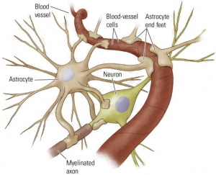
Astrocytes
Regulate blood flow
Nurture neurons
Participate in ensuring successful neurotransmission
Maintain plasticity
Respond to insults made to the CNS
Sofroniew, 2009
http://jonlieffmd.com/blog/astrocytes-control-synapse-function
Notes:
To understand the phenomenon – astrogliosis- it is important to know the nervous cells at play. Astrocytes are a type of glial cell that support the central nervous system or CNS by regulating blood flow and maintaining the integrity of the blood brain barrier, nurturing neurons through provision of metabolites, participating in ensuring successful neurotransmission, helping maintain plasticity, and for our lab, most importantly, responding to all forms of CNS insults.
Sofroniew MV. Molecular dissection of reactive astrogliosis and glial scar formation.
Trends Neurosci. 2009;32(12):638-647. doi: 10.1016/j.tins.2009.08.002 [doi].

Slide 3
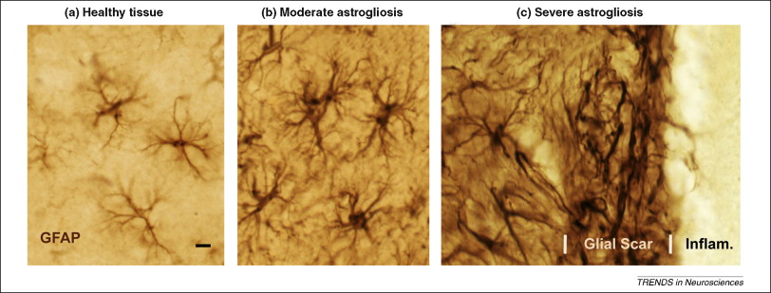
Astrogliosis
Reactive astrocytes
Hallmarks: Glial Fibrillary Acidic Protein (GFAP) upregulation and hypertrophy
Persistance can be maladaptive
Sofroniew MV. Molecular dissection of reactive astrogliosis and glial scar formation. Trends Neurosci. 2009;32(12):638-647. doi: 10.1016/j.tins.2009.08.002 [doi].
Notes:
Reactive astrocytes are astrocytes that respond to injury by changing their morphology or molecular expression (Sofroniew, 2009). Usually, this means increased processes and in more severe cases, scar tissue formation (Sofroniew, 2009). Upregulation of GFAP is usually a sign of astrogliosis since it is a major component of astrocyte intermediary filaments (Pekny & Pekna, 2014). Reactive astrocytes in ischemia had neuroprotective effects, whereas reactive astrocytes induced by LPS exhibited more detrimental phenotypes (Zamanian et al, 2012).Thus, astrogliosis is disease dependent and graded (Pekny & Pekna, 2014). Persistance of astrogliosis in some cases can be maladaptive and could provide insight for clinical therapies (Pekny & Pekna, 2014).
Pekny M, Pekna M. Astrocyte reactivity and reactive astrogliosis: Costs and benefits.
Physiol Rev. 2014;94(4):1077-1098. doi: 10.1152/physrev.00041.2013 [doi].
Zamanian JL, Xu L, Foo LC, et al. Genomic analysis of reactive astrogliosis. J
Neurosci. 2012;32(18):6391-6410. doi: 10.1523/JNEUROSCI.6221-11.2012 [doi].

Slide 4
What We Understand
SRF: transcription factor that controls cell proliferation and differentiation (NCBI)
Downregulation of serum response factor (SRF) leads to astrogliosis (unpublished data from Dr. Ramanan’s lab)
Brain RNA-Seq Zhang et al.
Notes:
One player we have come to understand is serum response factor or SRF. From BrainSeq data, we can see that the transcription factor is highly expressed in astrocytes and from NCBI, we know it is a protein that controls cell proliferation and differentiation. From prior works in the lab, we have come to know that deleting SRF causes upregulation of astrogliosis in various areas of the brain.
Image: Zhang Y, Chen K, Sloan SA, et al. An RNA-sequencing transcriptome and splicing database of glia, neurons, and vascular cells of the cerebral cortex. J Neurosci. 2014;34(36):11929-11947. doi: 10.1523/JNEUROSCI.1860-14.2014 [doi].
FPKM: Fragments Per Kilobase of transcript per Million mapped reads

Slide 5
The Unknown
What other genes are important?
Is there a molecular pathway/order to astrogliosis?
Notes:
What we do not know is what other genes are at play and how they contribute to astrogliosis. For example, what other genes are important, and is there a specific order or pathway these genes are activated? Microarray data from the knocking out of SRF has provided some insight into what other genes may be involved in astrogliosis. Here we see the first four genes the Asmita tried to tackle through multiplexing, which were all also downregulated in SRF-KO mice.

Slide 6
Why a Multiplex Approach?
Genes Chosen for KO in Astrocytes
Srf
Fzd2
Fbxo30
Hsd11b1
Sc4mol
Nrarp
Acadl
Mfge8
Fut10
Rfx4
Slc25a42
Stard4
Lix1
Ranbp3l
Gpc5
Zfp62
Pvrl3
Notes:
Through the microarray data, several genes were recognized to be more significantly impacted by knocking out SRF. To knock out each of these genes one at a time to observe effects in mice after a certain period of time is not efficient. Rather, we can knock-out multiple of these genes at once, and then focus in on groups of genes that gave the most significant phenotypes. A single lentiviral system, CRISPR/Cas9 genome engineering tools, and the Golden Gate Cloning Method makes this process possible (Kabadi et al., 2014).
Kabadi AM, Ousterout DG, Hilton IB, Gersbach CA. Multiplex CRISPR/Cas9-based genome engineering from a single lentiviral vector. Nucleic Acids Res. 2014;42(19):e147. doi: 10.1093/nar/gku749 [doi].

Slide 7
Notes:
Idea:
Design sgRNA to target the interested genes to KO.
Clone each sgRNA into a different vector with a unique promoter.
Digest all these vectors so that unique promoter + sgRNAs are isolated and have compatible ends to other digested fragments from other vectors.
Ligate these cassettes into a single lentiviral vector that has Cas9 properties that is also astrocyte-specific
Kabadi AM, Ousterout DG, Hilton IB, Gersbach CA. Multiplex CRISPR/Cas9-based genome engineering from a single lentiviral vector. Nucleic Acids Res. 2014;42(19):e147. doi: 10.1093/nar/gku749 [doi].

Slide 8
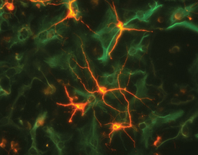
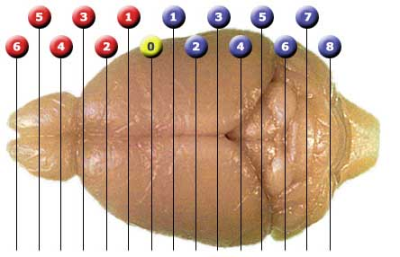
BbsI
pMU6
pLV-hUBC-Cas9-EGFP
Mfge8
Notes:
Big Picture:
The idea is to first add the four sgRNAs to a single Cas9 lentiviral vector using Golden Gate Assembly and cross checking with colony PCR, by running gels of digested vectors, and through sequencing the vectors. Then, once the final vector is ready, a midiprep must be performed and injected into a newborn pup followed by in-vivo electroporation. After 2 weeks, when astrocytes are more visible, the mice must be sacrificed and the brains must be sectioned. Utilizing IHC, astrogliosis could be seen visually and further tests could confirm molecular hallmarks of astrogliosis.
http://www.sonidel.com/sonidel/protocol-for-in-vivo-electroporation-into-mouse-and-rat-retina/
http://www.mbl.org/atlas170/atlas170_frame.html
https://www.rndsystems.com/products/neuron-specific-beta-iii-tubulin-antibody-tuj-1_mab1195

Slide 9
Major Experiments
1) Multiplex Group 1: confirming all four cassettes are properly inserted into a single lentiviral vector
Strain of E.coli
Golden Gate assembly: Kabadi et al vs. separate reactions
Colony PCR
Colony selection: blue-white screening, spotting satellite colonies
2) Step 1 for separate sgRNAs: adding new set of sgRNAs into unique vectors
Hsd11b1 and Slc25a cloning into phU6
Acadl and Stard4 cloning into phU6
Notes:
Experiment 1: Helping Asmita troubleshoot at the step where all four cassettes should be inserted into the lentiviral vector. This required manipulating strain of e.coli,…
Experiment 2: Independent single-cloning project

Slide 10
Genes Chosen for Knockout in Astrocytes that are compatible with phU6
Hsd11b1
5’ c a c c g g a a g a g c a c c a g g a t c g g g g t t t
g t g g c c t t c t c g t g g t c c t a g c c c c a a a 5’
Slc25a
5’ c a c c t g g t g c c c t t g c c a a a a c a g g t t t
g t g ga c c a c g g gaa c g g t t t t g t c c a a a 5’
Began cloning on 4/6/18
Notes:
SnapGene

Slide 11
Hsd11b1 and Slc25a cloning into phU6
Anneal oligomers (1a/1b) and create 1:250 dilution
Digest phU6 with BbsI for 4 -5 hours
Gel elute in 20 microL
1 hour ligation of vector with sgRNAs
Heat shock transformation into DH10b chemical competent cells
Plate on Kanamycin plates and keep at 37 degrees Celsius overnight
Patch colonies on Kanamycin plates overnight
Colony PCR
Pick positive colonies and inoculate
Digest to check integrity of plasmid
Send for sequencing

Slide 12
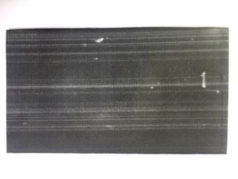
Minigel after gel elution
Purpose: to check that the ratio of digested vector to sgRNAs was appropriate enough to continue forward with ligation.
phU6 –BbsI digested vector

Slide 13
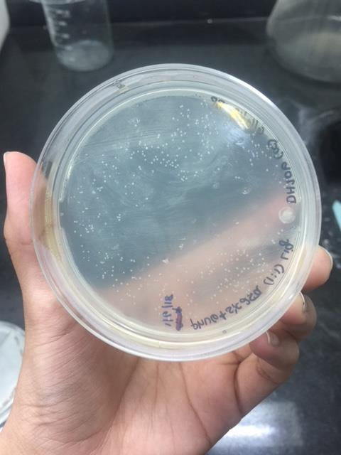
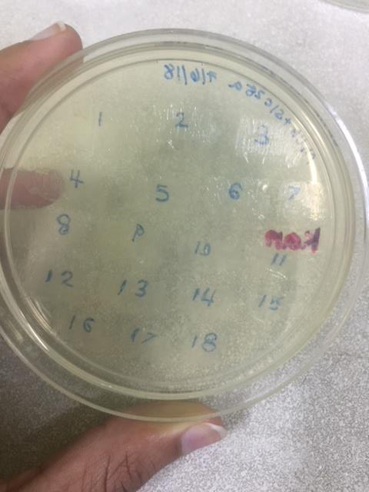
Heat Shock Transformation
Attempted to transform ligation mix into Endura chemical competent cells; however, only a few colonies grew on plates
Tried transformation into DH10b competent chemical competent cells
Transformation efficiency was much better
Transformed phU6 – slc25a
Patched phU6 – slc25a

Slide 14
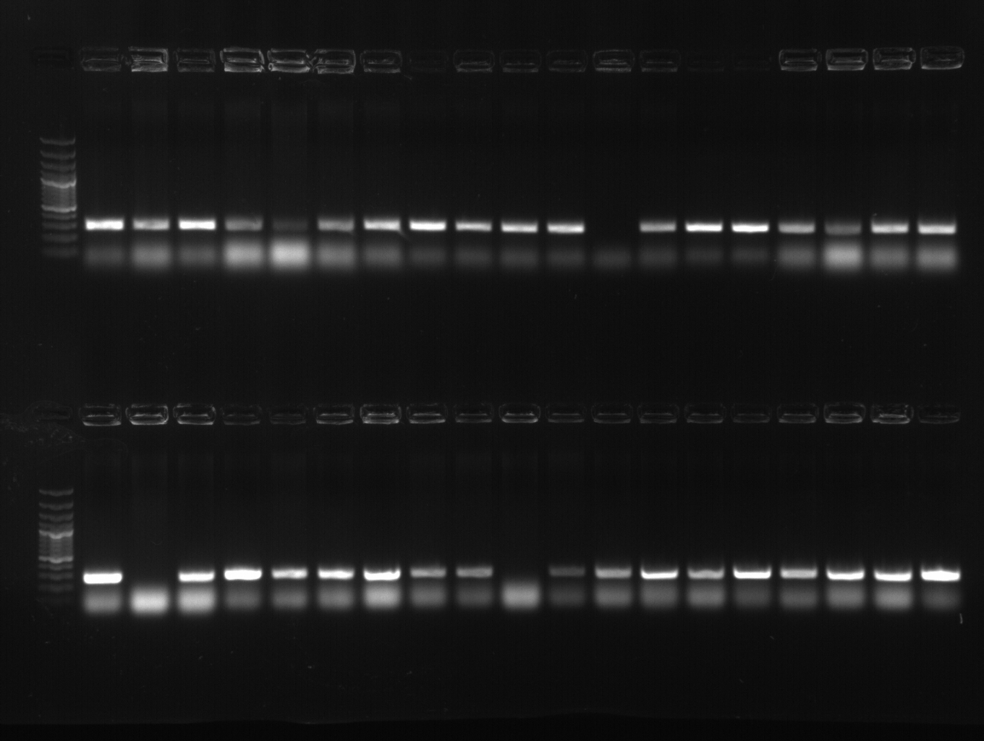
Colony PCR Results
100 bp plus ladder
phU6 - Hsd11b1 PCR reaction:
Forward primer: U6 – Pro –F
Reverse primer: Hsd11b1 – sgRNA – 1b
Expected band size: 273 bp
phU6 - Slc25a PCR reaction:
Forward primer: U6 – Pro –F
Reverse primer: Slc25a – sgRNA – 1b
Expected band size: 273 bp
100 bp plus ladder
Positive colonies chosen to be inoculated for miniprep

Slide 15
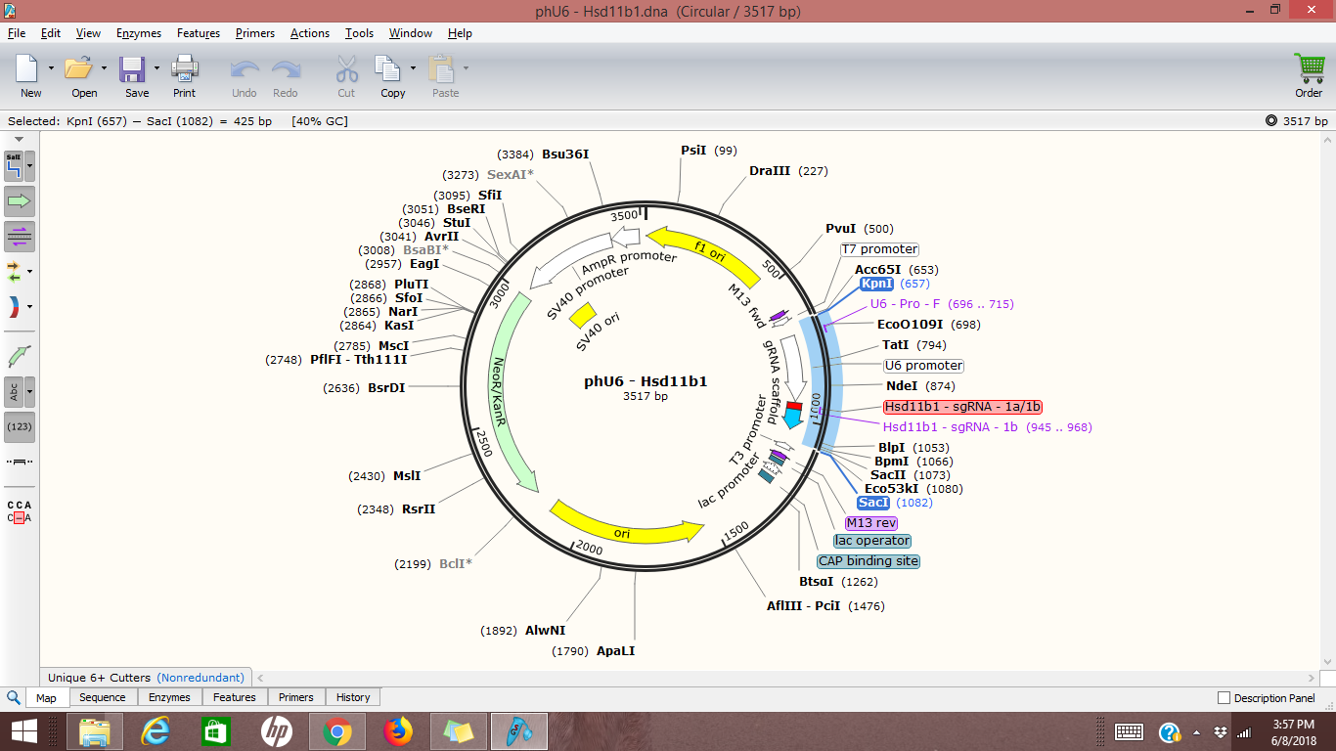
Digestion of miniprep to check integrity of vector
Enzymes used: SacI and KpnI; expected band sizes: 425 bp and 3092 bp

Slide 16
phU6 – hsd11b1 colony #1
phU6 – slc25a colony #15
phU6 – hsd11b1 colony #8
phU6 – slc25a colony #5
Results of Digestion of miniprep samples
Expected 3092 bands
1 kb plus DNA ladder
Expected 425 bands
*Bands got fainter as I continued to resolve the ladder

Slide 17
Overall Results
In progress
Not all PCR results are positive, suggesting not all promoter-sgRNA cassettes are in the vector
Hard to transform such a large vector (14kb)
Close to standardizing the multiplexing process to observe further downstream effects
Four clones were successfully made
Notes:
Helped standardize step 1 of the multiplexing process

Slide 18
Future Direction
Standardization of the Golden Gate Assembly process
Utilizing SURE2 chemically competent cells
Running Colony PCR for blue colonies as well
Running PCR to amplify smaller fragments
Adding Astrocyte specificity to the PLV vector utilizing recombineering
Managing to engineer a vector that could knockout genes of interest in only astrocytes to observe its effects on astrogliosis

Slide 19
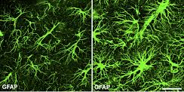
Impact
Astrogliosis is an acute response to almost all CNS insults: neurodegenerative diseases, trauma, immunological insults
Knowing the processes that underlie reactive astrogliosis can present targets for clinical therapies
Help reduce neurological impairment
Image edited. Pekny & Pekna, 2014.
Notes:
Pekny M, Pekna M. Astrocyte reactivity and reactive astrogliosis: Costs and benefits.
Physiol Rev. 2014;94(4):1077-1098. doi: 10.1152/physrev.00041.2013 [doi].

Slide 20
Scientific Questions?

Slide 21
US Bose Scholarship Reflection

Slide 22
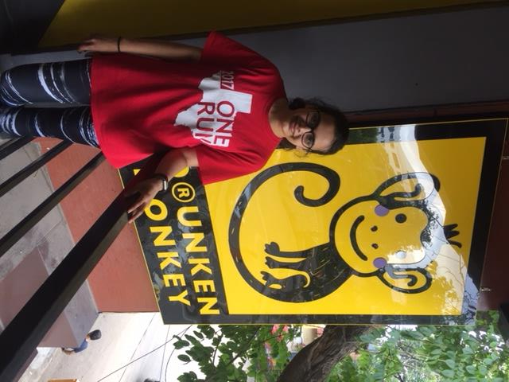
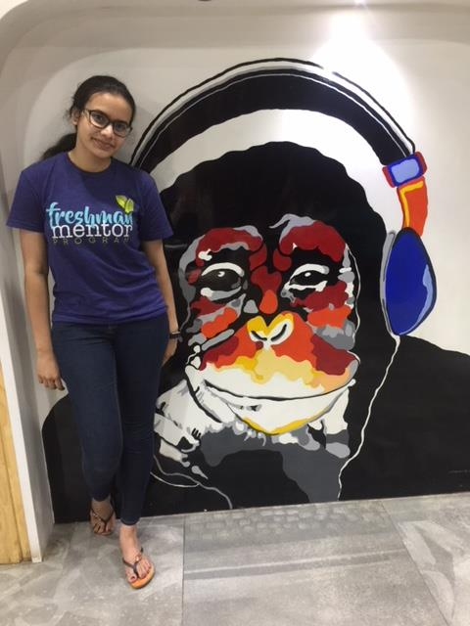
Bangalore
Notes:
Great weather, friendly people, good food, very clean, very green
Rains a lot

Slide 23
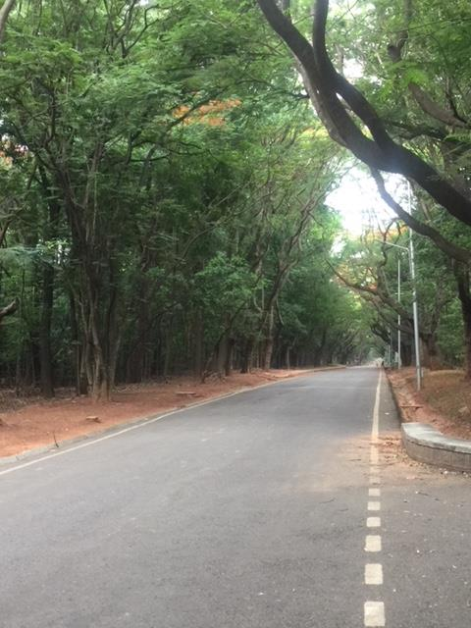
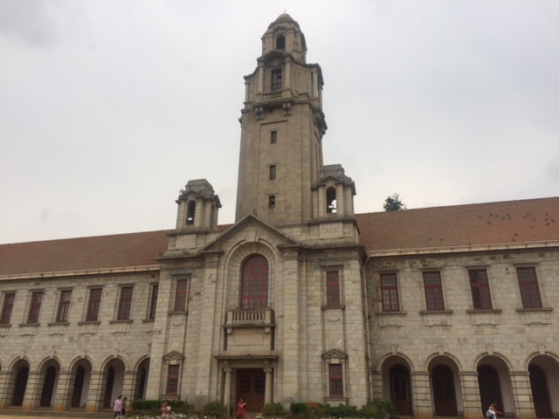
Indian Institute of Science
Notes:
HUGE, almost 20 mins to walk to my own lab
Very green/picturesque
Has a very serious/passionate student body

Slide 24
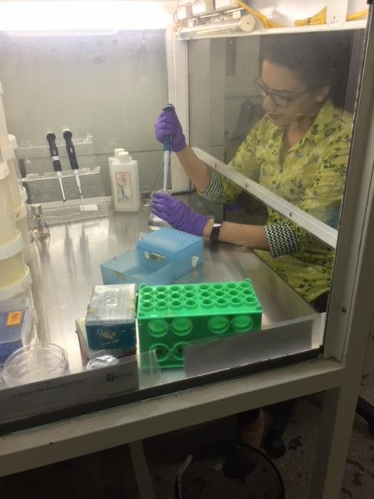
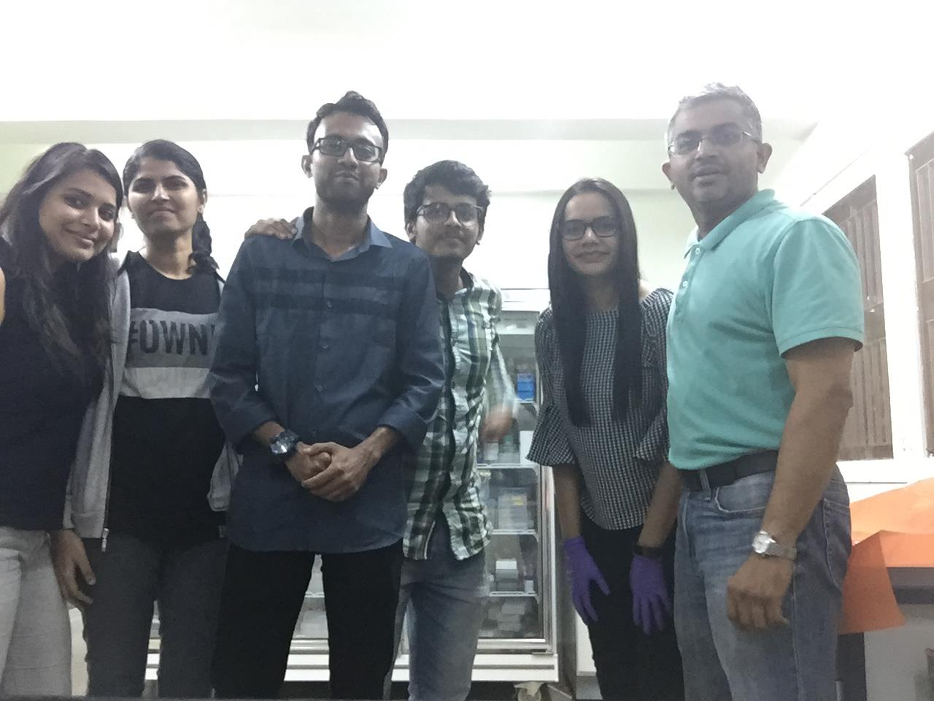
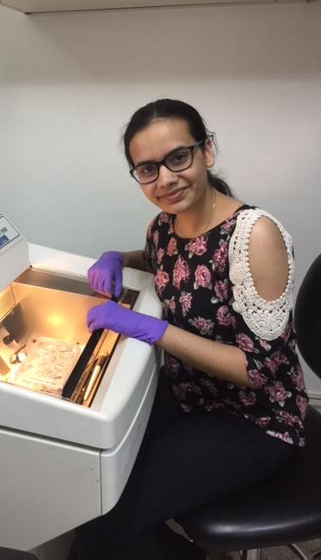
Centre for Neuroscience
Notes:
Loved it!
Absolutely open and in the green.
Great team of people to work with.
Had state-of-the-art tools and equipment
Good opportunity to try many techniques

Slide 25
Thank You

