Slide 1
Investigating the mechanism of Orb2 dependent long-term memory maintenance in Drosophila
Natalie Galles
S. N. Bose Research Exchange
Summer 2016

Slide 2
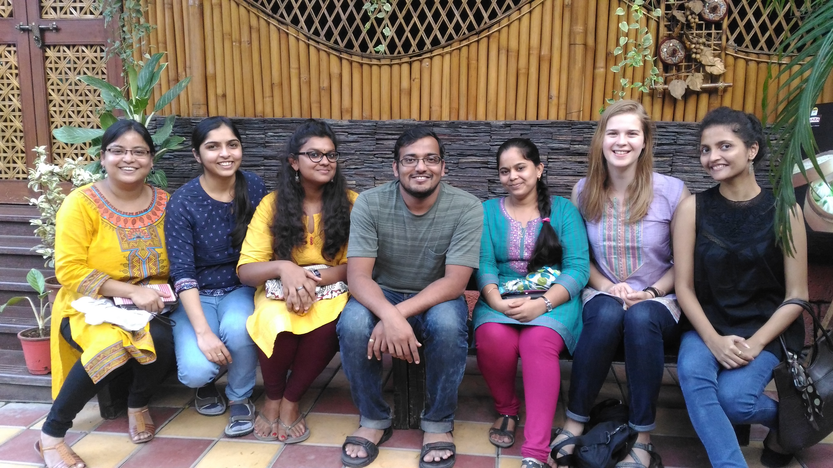
Lab 11 nccs – pune
Internship at NCCS, Pune
Spent my 8 weeks working in Lab 11 under direction of Dr. Amitabha Majumdar
Neuroscience
Studying the proteins regulating memory maintenance in Drosophila

Slide 3
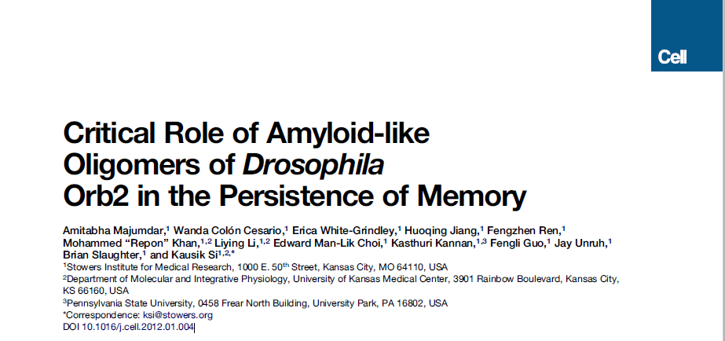
Research background
What or which proteins explain why some memories last and others don’t?
Proteomic differences in short vs. long-term memory maintenance?
Orb2 identified as the key memory-regulating protein in Drosophila
Two key isoforms: Orb2A and Orb2B
Orb2 aggregates into amyloid-like oligomers in the synaptic membrane
How does the oligomerization of Orb2 affect the formation of long-term memory?

Slide 4
Research background cont.
Oligomerized Orb2 is required for the formation of lasting memory, and the different isoforms of Orb2 present dictate how the protein will function and the memory preserved
Orb2A is critical for self-assembly of Orb2 oligomers
Activator
Orb2B is more common Orb2 isoform and found in highest concentration in monomeric Orb2
Repressor
Which chaperones help determine the oligomerization state of Orb2?

Slide 5
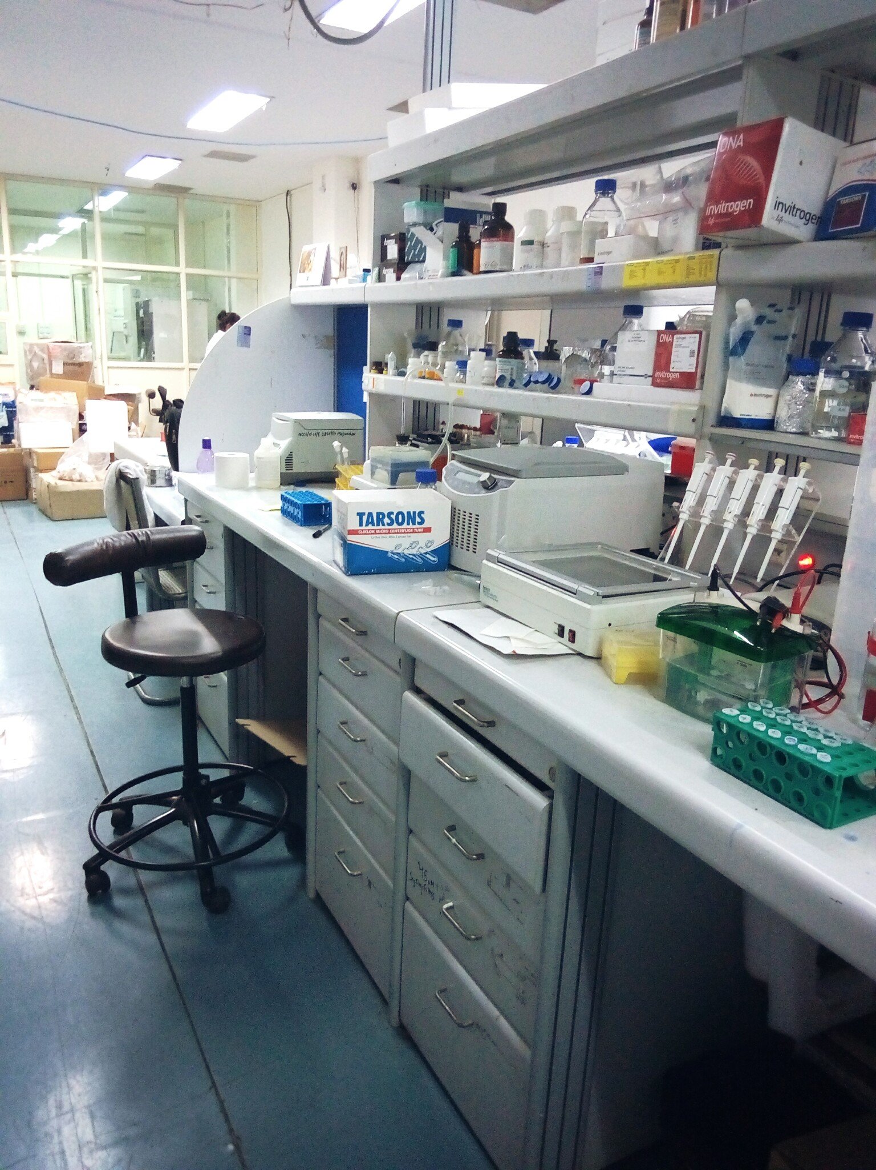
main objectives – Summer 2016
Orb2 chaperone protein screening and identification
40 uncharacterized Hsp40 isoforms noted to potentially affect Orb2 function
1. Purification and isolation of chaperones for appropriate antibody detection
2. Neural imaging analysis of flies over and under-expressing Orb2 and different chaperones
Drosophila as model organism
Lab <1 year old so still in early stages

Slide 6
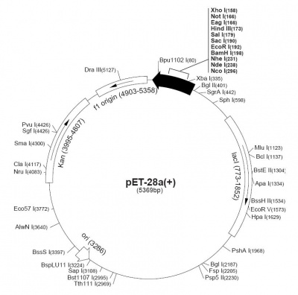
1. Protein Purification & isolation
Preparation of Pet28a vectors containing DNA chaperone inserts of interest
Preparation of S2 Drosophila cell lines receptive for bacterial transfection
Overexpression of each chaperone
Purification of the 40 screened chaperones of interest
Generate antibodies against each chaperone
Isolate interaction of overexpressed Orb2 with each chaperone to identify specific protein interactions
Also study of interacting protein affinities and kinetics

Slide 7
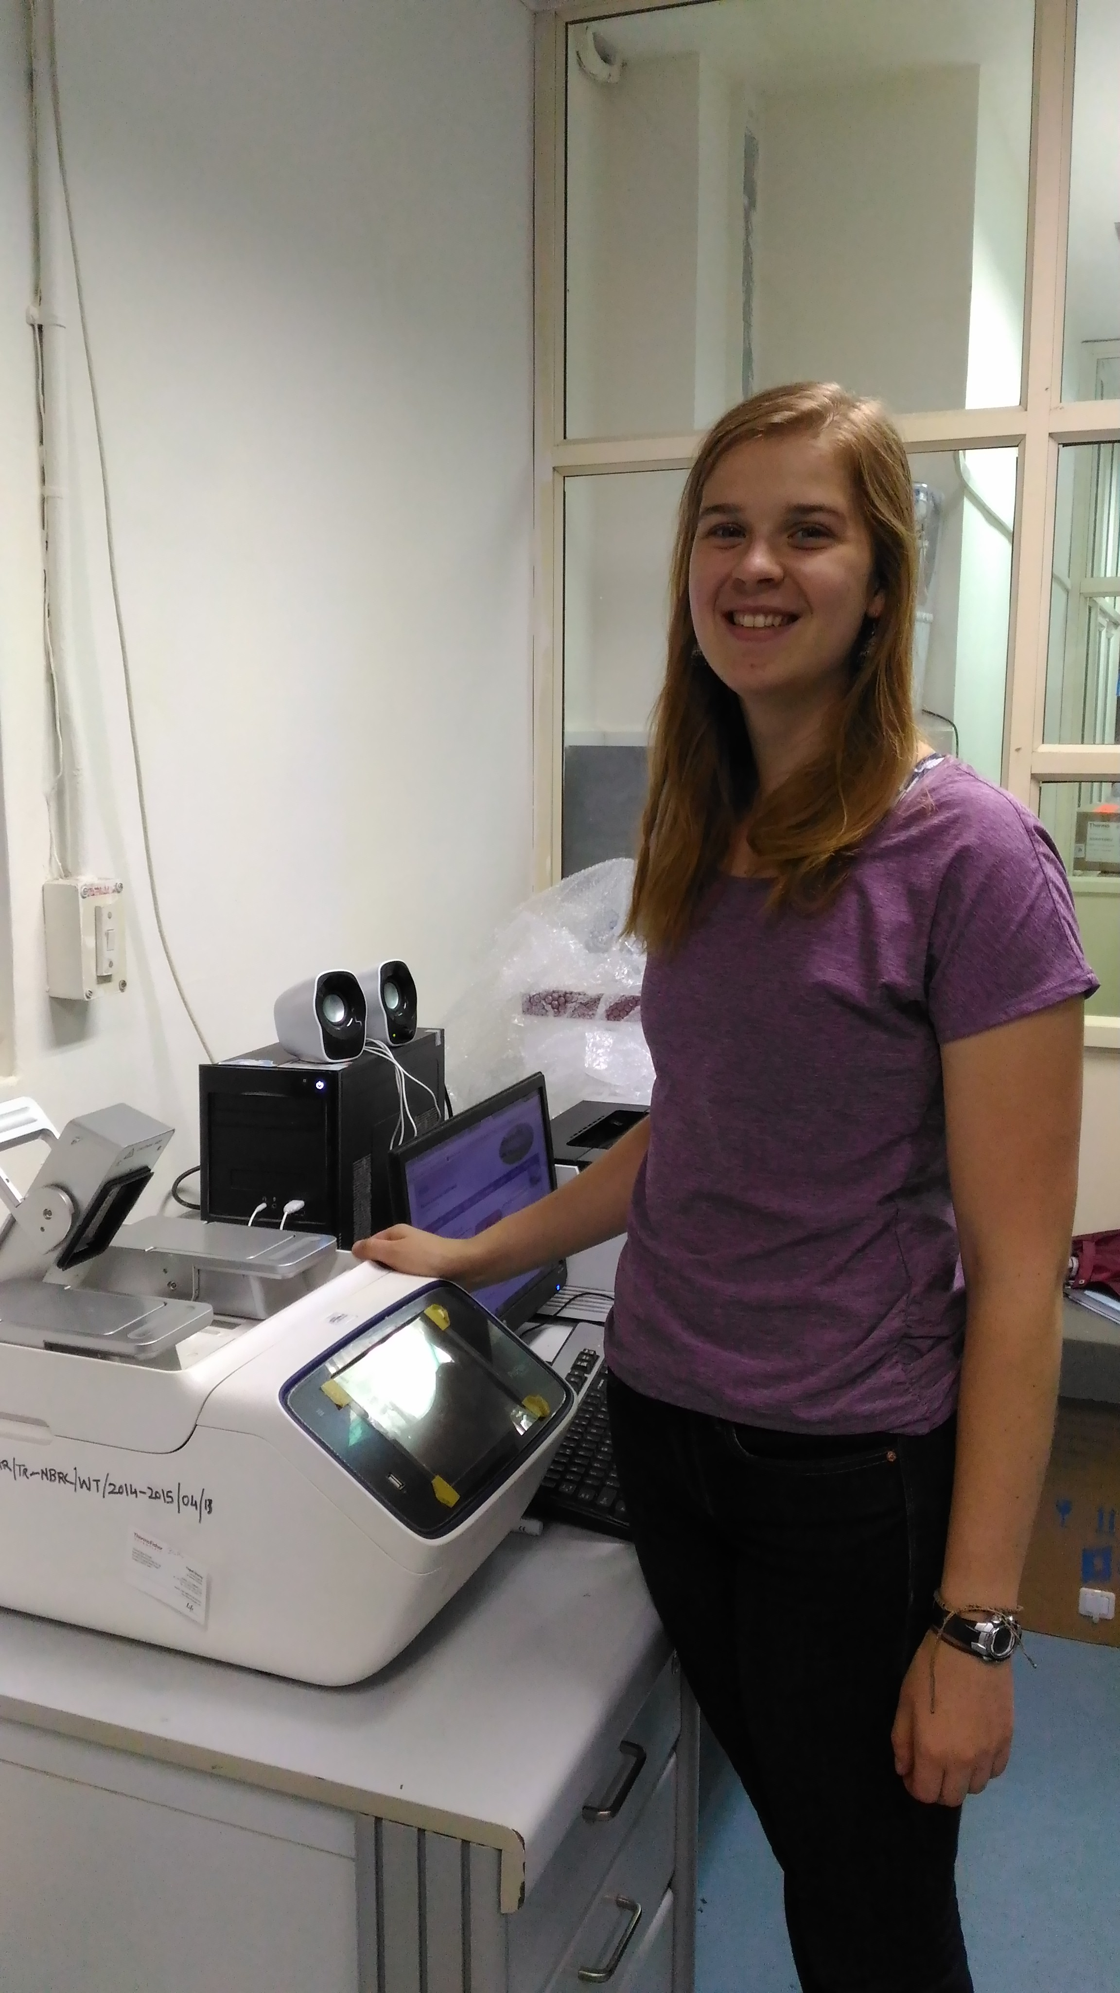
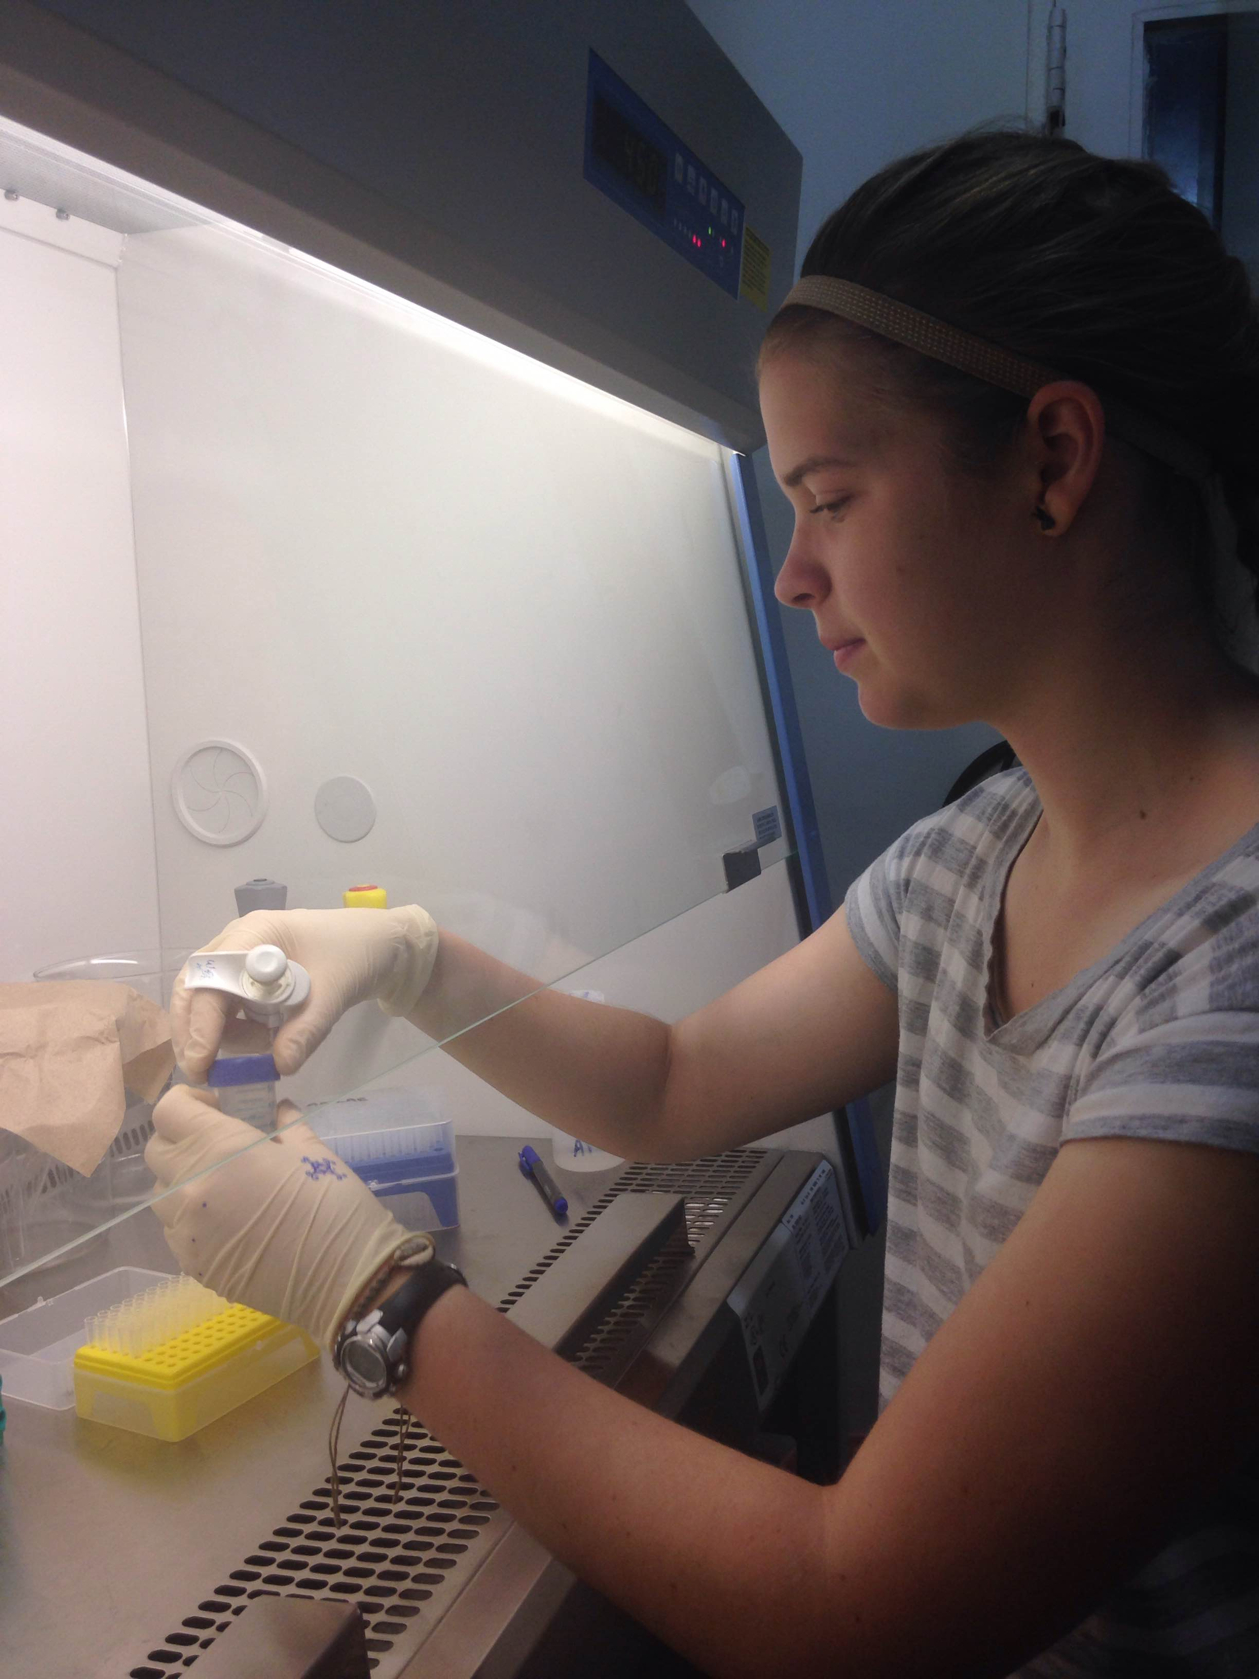
PCR Cloning
Bacterial transformation
Protein purification via centrifugation
Agarose and SDS-Page gels
Western blot analysis
Chemiluminescent and immunofluorescent imaging techniques
DNA digestion
Plasmid miniprep for sequencing

Slide 8
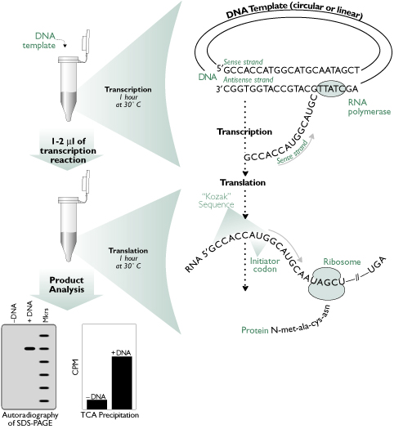
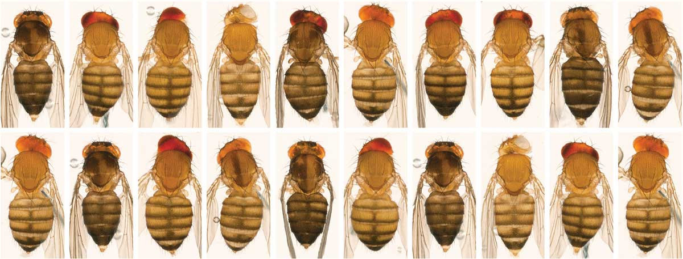
Free cell translation assay
In vitro analysis using primed cell transcription machinery to process inserted DNA of interest
Developing Free Cell Transcription and Translation assays using Drosophila embryo extracts
Drosophila embryo extraction responsibilities
Luciferase activity (luminescence) as reporter
Oligomerized Orb2 binds to specific gene (Tequila) in brain
Enhanced luminescence from more Orb2 binding indicates chaperone assistance or not
Many benefits to assay
Further standardization still required
Notes:
Benefits:
-overexpression of genes without toxicity
-very selectively control which proteins are interacting
-test tube analysis controls for variables difficult to standardized in in vivo procedures

Slide 9
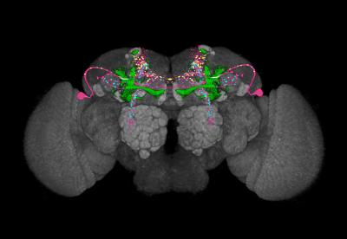
2. Neural imaging analysis
Neural imaging analysis of flies over and under-expressing Orb2 and different chaperones
Controlled by crossing known fly lines to analyze protein interactions
Mushroom body structures illustrate connected neural circuitry required for learning
Fluorescence microscopy techniques

Slide 10
Findings so far
New lab
Current focus on making reagents, purifying proteins, and standardizing new procedures before rigorous analysis
Goal to better understand how Orb2 functions in Drosophila
Hopeful implications to better understanding human neurodegenerative diseases

Slide 11
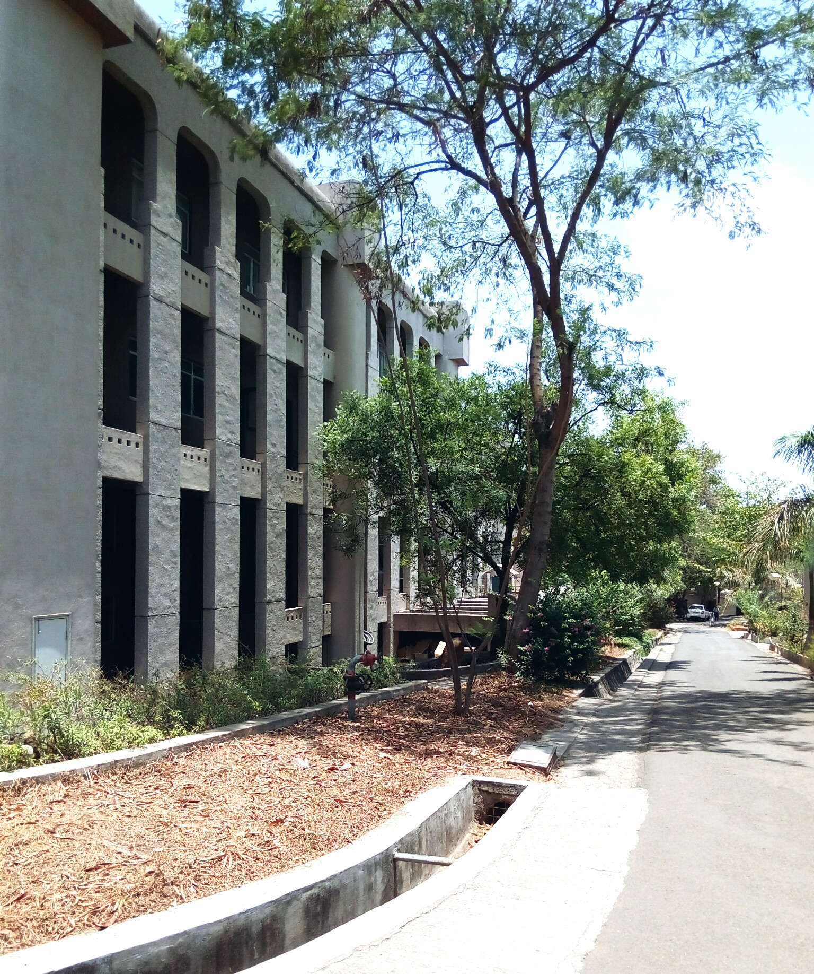
Lots of learning
Protocols & procedures
Drosophila as a model organism
Indian graduate student mentality
Only Bose student in Pune

Slide 12
Thank you!

