Slide 1
Zero TB Program – Quality Improvement Investigations
Noah Borchardt

Slide 2
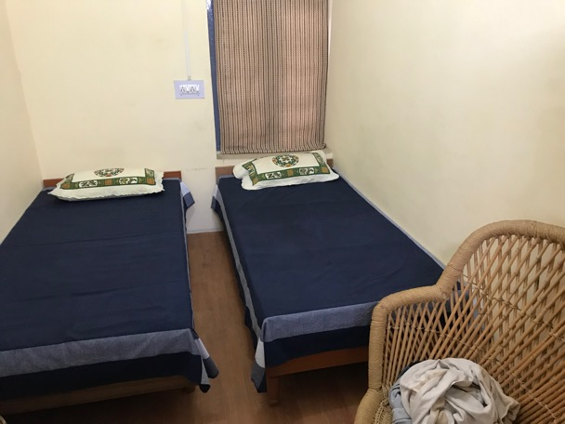
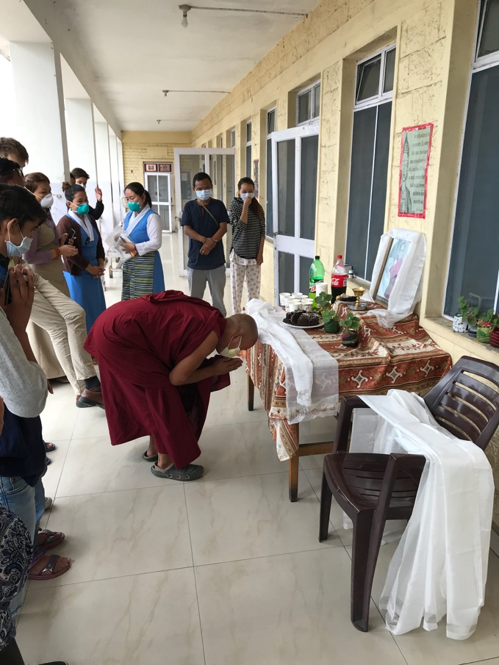
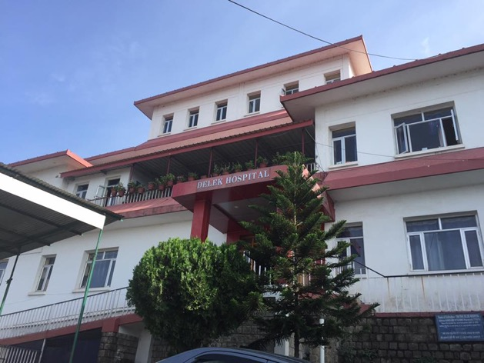
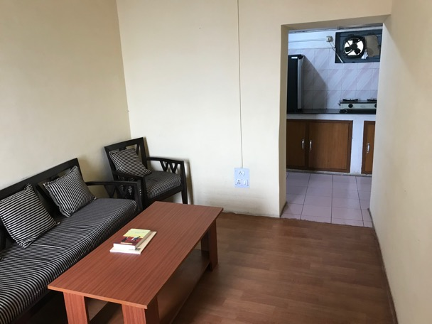
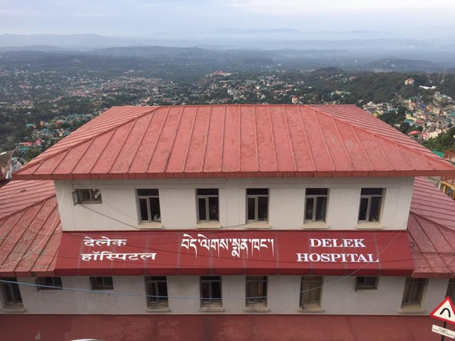
Life in Little Lhasa

Slide 3
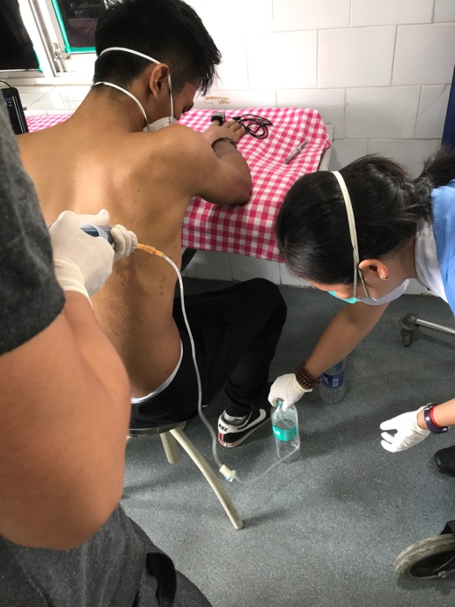
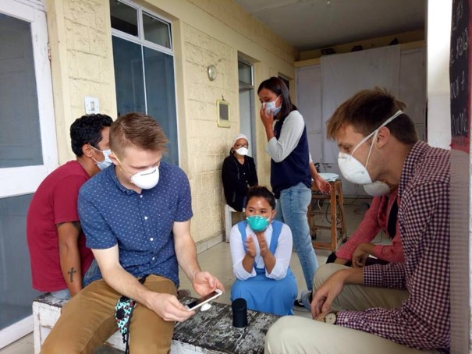
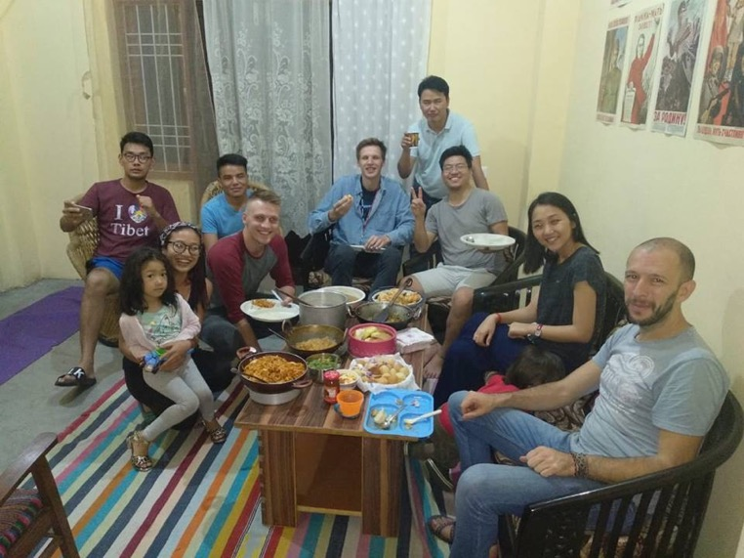
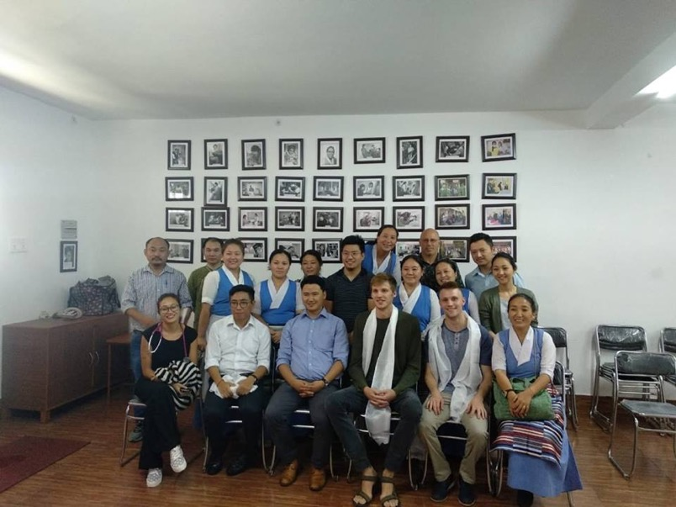
Life in Little Lhasa

Slide 4
Major Focuses:
Assessing impact of Zero TB Screening in the schools through School Nurses and Student Interviews
To identify factors considered by monks and nuns in the decision to take/refuse latent TB treatment
To assess staff perceptions and practices in regards to TB screening and Infection Control at Delek Hospital

Slide 5
Sources of Data
Student Interviews
8+ interviews (40+ students)
School Nurse Interviews
6 interviews (7 School Nurses)
Monk and Nun Interviews
6 focus groups (18 monks)
Monk and Nun Surveys
Distributed to 2 nunneries and 3 monasteries
161completed
Delek Staff Interviews
8 Interviews in each department (15+ staff members)
Delek Staff Surveys
34 completed
Notes:
Sam

Slide 6
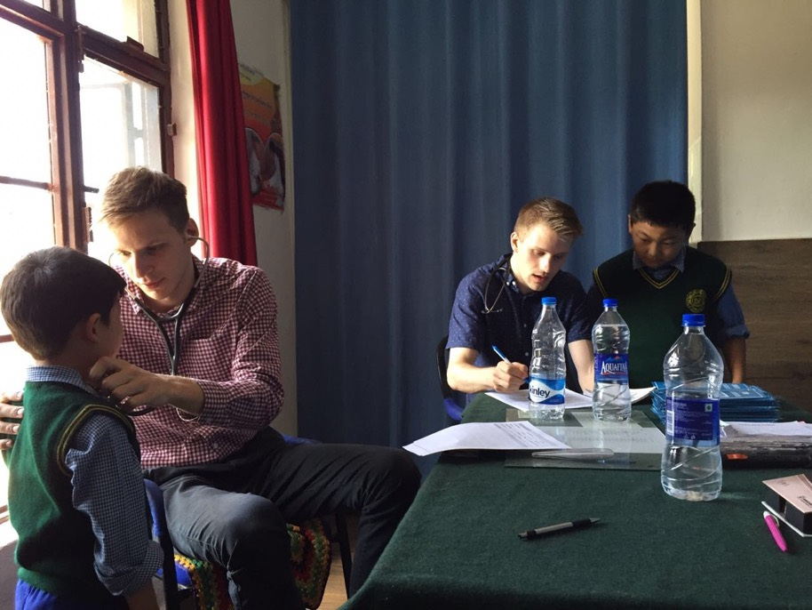
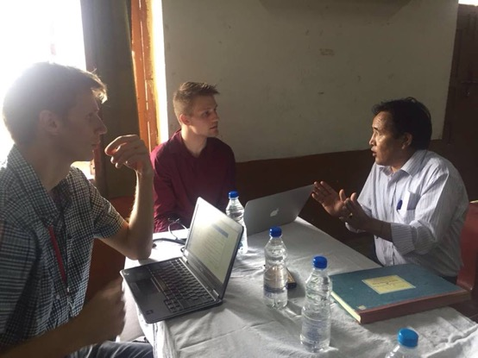
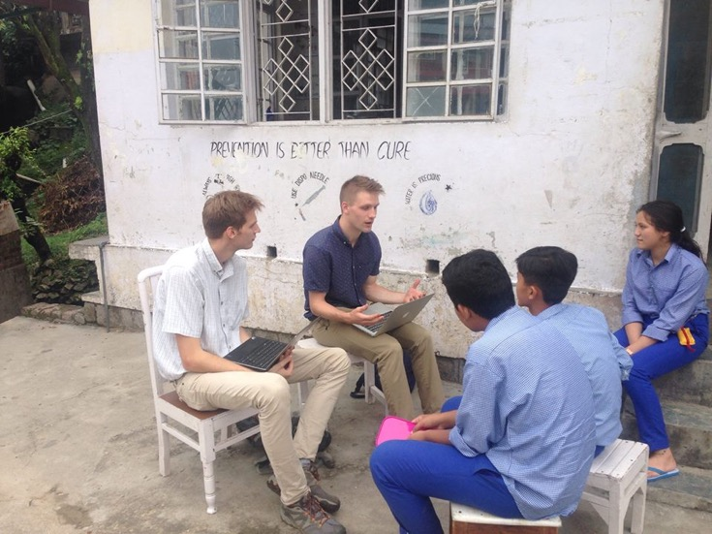
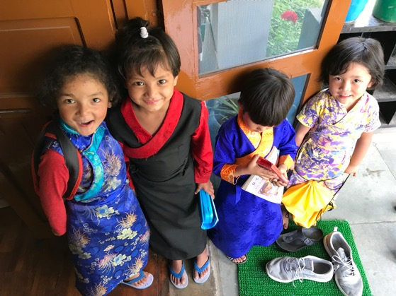
Tibetan Children Villages

Slide 7
Findings from School Nurse and Student Interviews
Topic | Findings
Impact of Zero TB | Noticed a reduction in the TB cases since screening has started Increased awareness and education among students and their families Feelings of shared ownership of the program
Challenges | Educating parents and addressing their concerns Patient management (isolation, side effects, psychological well-being) Misconception that LTBI treatment provides life-long protection
Notes:
Sam

Slide 8
Findings from Student Interviews
Topics | Findings
Knowledge | High levels of knowledge and awareness of TB symptoms, transmission, and treatment among the older students.
Stigma | No feelings of stigma for LTBI patients Low levels of stigma/isolation towards Active TB patients
Side effects | Students tolerating medicine Side effects: red urine, nausea, sleepiness, pimples

Slide 9
Recommendations
Currently
School Nurses are educated on TB by the Doctor and TB Nurses
School Nurses disseminate this information to home mothers and to parents of latently infected children
Recommendation #1
Create education material for the School Nurses to assist in this process
A document for the home mothers
Would ensure the treatment providers are getting the right information
A document geared for parents
Would help concerned parents get the correct, program specific information
Recommendation #2
Consider contacting patients who have previously rejected treatment to update them on the regimen changes and the success of the program.
Notes:
Noah

Slide 10
Recommendation #3
Currently
Refer to LTBI Therapy as “Preventative Therapy”
Results in Patient confusion – Preventative Therapy = Vaccine
Infers that this treatment will protect the patients for life
Explaining this misnomers downplays the importance of the treatment
Also Infers that the patient is not currently infected
Recommendation #3
The ATS and CDC have recommended avoiding the terms “preventive therapy” and “chemoprophylaxis” as they can be confusing or misleading. To describe the intervention more accurately, the terminology “treatment of LTBI” is preferred.
RPT could now stand for “Rifampicin Pre-emptive Treatment”
Notes:
Noah

Slide 11
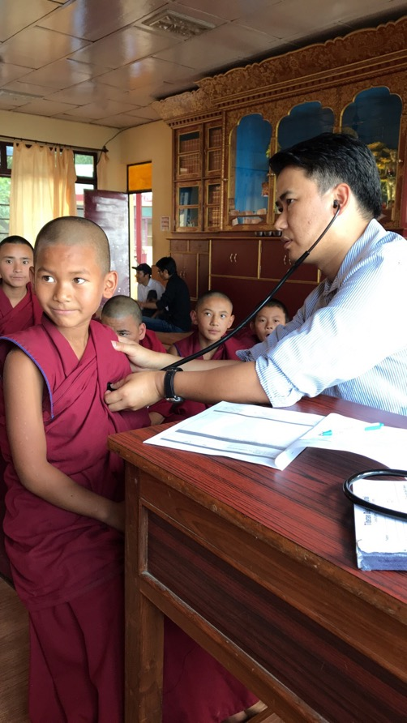
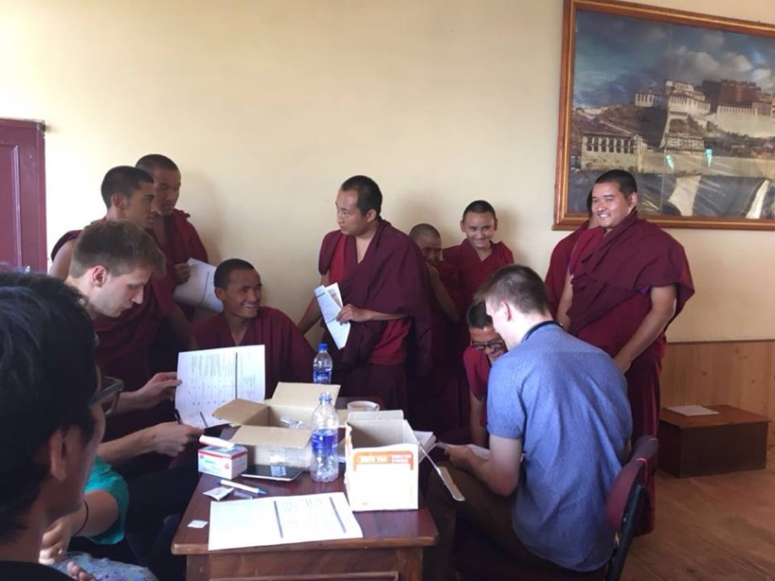
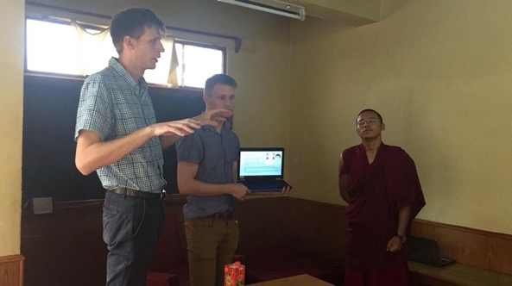
Monasteries and Nunneries

Slide 12
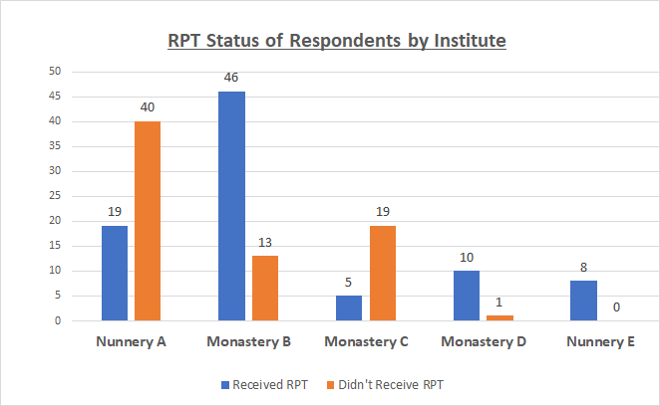
Findings from Survey of Latently Infected in Monasteries and Nunneries (161 respondents)
Demographics of Respondents
Sex | n | %
Male | 93 | 57.8%
Female | 68 | 42.2%
Total | 161
Age
<18 | 14 | 8.7%
18-25 | 35 | 21.7%
26-35 | 53 | 32.9%
36-45 | 35 | 21.7%
46-55 | 17 | 10.6%
55+ | 6 | 3.7%
Designation
Monk | 84 | 52.2%
Nun | 67 | 41.6%
Office Staff | 7 | 4.3%
Other | 3 | 1.9%
RPT Status
Received | 88 | 54.7%
Didn’t receive | 73 | 45.3%

Slide 13
Knowledge Section
Question (Correct Answer) | % Correct | % Incorrect | % Didn’t answer
Q1: What are the symptoms of latent TB? (No symptoms) | 54.7% | 38.9% | 6.2%
Q2: Does a positive skin test mean you have active TB disease? (No) | 42.2% | 56.2% | 1.2%
Q3: Can latent TB be spread from person to person? (No) | 30.4% | 67.9% | 1.2%
Q4: How is latent TB infection treated? (Prescribed TB Medicine) | 41.0% | 52.5% | 6.2%
Q5: The benefits of treating latent TB infection is? (To prevent active TB disease) | 39.8% | 27.2% | 32.9%
Q6: How long does the treatment last? (4 months) | 50.9% | 42.6% | 6.2%
Average Score: 2.59 out of 6 (45.3%)
Knowledge scores higher in those who refused RPT vs those who accepted RPT
Received RPT: 2.23 out of 6
Did not receive: 3.03 out of 6
P < 0.005
However, likely due to variation by institute

Slide 14
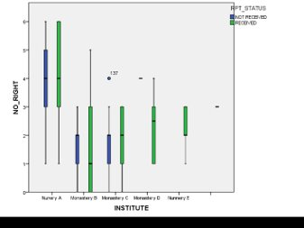

Slide 15
Survey Findings cont.
Attitude Questions | Received RPT | Didn’t Receive
Do you think the benefits of Latent TB treatment outweigh the risks? | 79.5% | 59.7%
Do you think eating healthy and exercising is sufficient to prevent active TB disease? | 60.2% | 61.6%
Do you think individuals living in a monastery or nunnery are at a higher risk for TB than other Tibetans? | 71.8% | 75.3%
Do you think taking latent TB medicine benefits the community? | 90.9% | 72.7%
Practice Question
If you had a positive skin test for TB, would you choose to take the preventative TB treatment? | 69.3% | 13.5%
Reasons indicated for refusal of RPT
I don't think I'll get active TB because I am healthy (40%)
Worried about the side effects (17%)
I have other health conditions (14%)
The treatment is too long (13%)

Slide 16
Findings from Monk and Nun Interview (6 focus groups, 3 participants each)
Motivating Factors for LTBI Treatment | Deterring Factors for LTBI Treatment
Perceived benefit to individual health “One medicine now is better than four or five if active TB” Perceived community benefit Witnessed fellow monk/nun with TB in the past | Possibility of reinfection Fear of side-effects (forgetfulness, hepatotoxicity, gastritis) Peer had negative experience with active TB regimen (“I heard from my peer…”) Other health problems (e.g. Anemia in the nunneries) Aversion to Western Medicine Low perceived likelihood of getting sick Length of treatment (“120 days is too much”)
Peer-to-peer discussion often plays a role in decision-making
Notes:
Sam

Slide 17
Recommendation #4
Standardization of education using a power-point presentation or checklist of topics
Incorporating peer-to-peer education
Involving monks and nuns who have completed treatment in the education of newly identified Latent TB cases
Examples:
Emphasizing potential Community Benefit
Goal of reducing the pool of bacteria in the monastery
Incorporate Buddhist concepts of community altruism
Clarify the difference between regimens for active and Latent TB
LTBI Therapy reduces the life-time risk of developing active TB by between 90% and 60% (Menzies et al 2010, WHO)
Notes:
Noah and Sam

Slide 18
Findings from Delek Staff Interviews and Surveys
8+ interviews/focus groups and 35 survey responses
Risks of TB exposure and developing active disease are common concerns expressed by the staff.
Many staff members have admitted suspicion of or confirmed latent Infection.
None have under-went latent TB treatment
Reasons: high perceived risk of reinfection, possible infection with MDR bacteria, low likelihood of reactivation
70% stated they would take LTBI treatment while working at Delek Hospital
87% stated they would consider LTBI treatment after leaving Delek Hospital
Significant proportion of staff have utilized TB screening methods:
Usually only after development of TB-like symptoms
TB Case Type | % staff with contact at least weekly
Suspected TB | 76%
Confirmed TB | 68%
Sputum (+) TB | 56%
MDR/XDR | 35%
Screening Technique | % of Staff | % in last 2 year
TST/Mantoux | 26% | 21%
Chest X Ray | 65% | 44%
GeneXpert | 21% | 15%
Sputum Smear | 29% | 21%
Culture | 9% | 6%
Notes:
Sam

Slide 19
Recommendation #5
Findings:
5 physicians and 5 TB nurses = 10 total asked via survey
Should TCV students take latent TB treatment if they have latent TB:
4 Strongly Agreed, 6 Agreed
Should Monks and Nuns take latent TB treatment if they have latent TB:
3 Strongly Agreed, 6 Agreed, 1 had No Opinion
Would you accept LTBI therapy right now?
4 said Yes, 6 said No
After leaving Delek?
8 said Yes, 2 said No
Is it possible for TB to be eradicated in the Tibetan Population in India?
3 Strongly Agreed, 6 Agreed, 1 Disagreed
Recommendation:
Address provider views and biases
Rationale:
Physicians exert substantial influence on patient compliance. (Koulayev et al. 2013)
Physician’s vaccine confidence and vaccine behavior has significant influence on vaccine acceptance of patients (Paterson et al. 2016)
Notes:
Noah

Slide 20
Recommendation #6
Findings:
35 Staff Surveys Completed – 100% responded that they would support some kind of yearly screening
15 Staff interviews
Staff members are aware that they can do a medical check-up, have tests, and obtain treatment whenever they want free of charge
Due to the staff being busy, they will often avoid medical check-ups until they have symptoms
Recommendations
Develop a yearly screening for active TB (symptom evaluation, TST, chest x-ray) for all hospital staff
Delek should come up with a primary care schedule for the staff and their families (how often they should come in for check ups, what should be investigated at each check up (TB, Hep B, Pap Smear, blood pressure) vaccine schedule)
Have a way of encouraging or incentivizing adherence
Medical screenings, offer vaccines (Hep B) for new-hires
Rationale:
Delek staff should avoid transmission of TB to patients
Delek provides health care for all employees so it is financially beneficial to keep them healthy
Points of concern: Privacy, Cost Effectiveness,
Notes:
Noah

Slide 21
Infection Control Concerns Expressed during Interviews
Infectious patients are coughing all the way to the lab. Should have their blood drawn by the nurses and the sample sent to the lab
Patients should be asked if they have a cough on registration in OPD and be offered a free mask and separate sitting area
Infection control measures are not adequately followed by staff in OPD (not wearing masks, patient not facing out window)
There should be periodic infection control education sessions for the staff (including administration, cleaning staff, and others)
There is no separate room for gastric aspiration or nebulization for TB patients
N-95 masks are worn for longer than standard recommended time
Should transfer patients to TB ward sooner
Should be more strict about isolation room doors being closed
There should be check-ups to ensure staff is adhering to infection control protocol
There should be better triage protocol in the OPD
No ventilation in toilet or in X-ray room in OPD
There should be more emphasis on patient education relating to infection control
Nurses are not always observing patients take DOT medications in TB ward.

Slide 22
Recommendation #7
Recommendation:
Establish a committee that meets regularly to discuss how to strengthen infection control procedures at Delek Hospital
Should include individuals from different departments (TB nurses, Doctors, Admin, Lab
Should involve Administrator Dawa and Dr. Tsetan
Should serve as a safe place for Staff to report concerns
Rationale
An opportunity to raise concerns and brainstorm cost-effective solutions to key infection control issues
Goal: to protect patients and staff from unnecessary exposure to infectious disease
Target Areas in Infection Control
Ensuring proper isolation in hospital in-patient Avoiding transmission in shared spaces (Lab/X ray room/waiting room/ bathrooms) Early identification of suspected TB cases in OPD patient flow Staff education (new and recurrent) Patient education
Notes:
Both

Slide 23
Updating the TB Manual
Goals:
To update manual with current guidelines
To document Delek's unique approach to TB care and share with other Tibetan TB centers
Sections Completed
Section 1: History of Delek TB Programme and Epidemiology of TB (Data from 2015-2017)
Section 2: Diagnostics of TB
Section 3: Clinical Management of Drug Susceptible TB
Impressions:
Unique diagnostic algorithm followed at Delek (captured) compared to other WHO and RNTCP guidelines
Discrepancies in initial patient education
Need to standardize treatment monitoring
Notes:
Sam

Slide 25
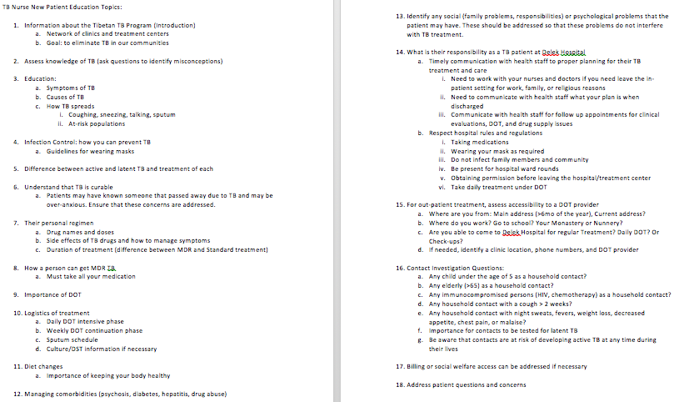
New TB Patient Education Checklist and Treatment Checklist
Notes:
Noah

Slide 26
Monitoring Schedule for DS-TB

Slide 27
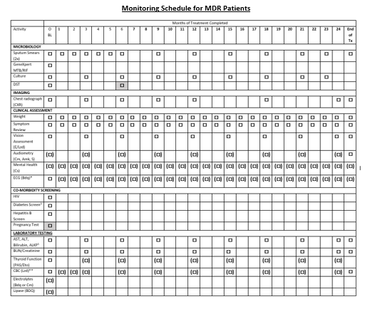
Monitoring Schedule for MDR TB
Note: this chart is still in progress

Slide 28
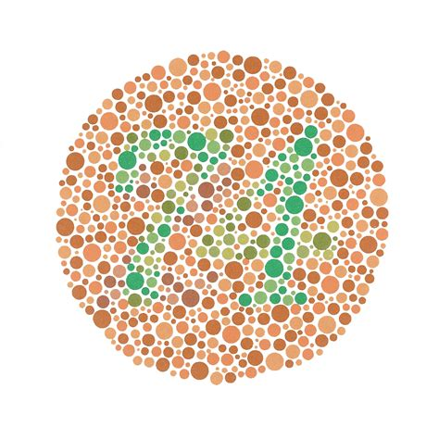
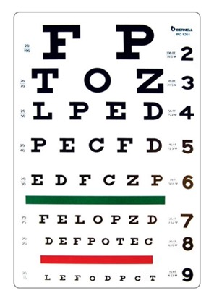
TB Patient Vision Testing
Recommendation
Recommended screening monthly for TB patients while on medications that can cause optic neuritis (ethambutol and linezolid)
Components of Testing
Symptoms check – changes in vision
Visual Acuity – Snellen Test
Red-Green Color Discrimination – Ishihara Test
Snellen Test Ishihara Test
Notes:
Sam

Slide 29
Future Research Projects
Hepatitis B Epidemiological Investigation
Anemia in the Nunneries
Diabetes
Investigation of the Tibetan Diet
Quality Improvement Projects
Case Studies (Bedaquiline)
Develop a Primary Care Schedule for Employees and Families

Slide 30
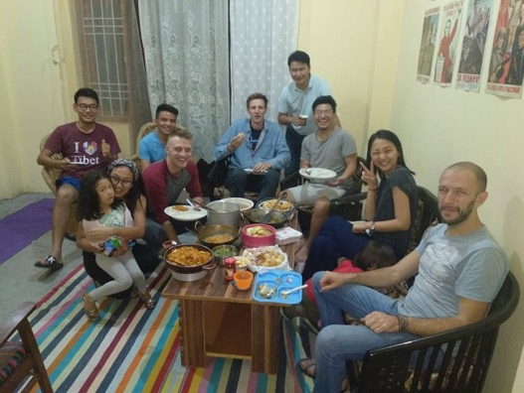
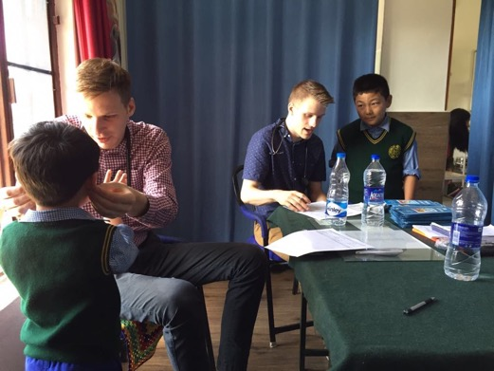
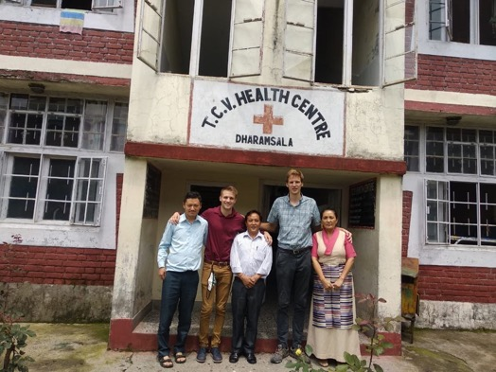
Thank You!!!

