Slide 1
Summer 2019 Research
Bronte Ellsworth in Maria Thaker’s Ecological Science Lab Indian Institute of Science Bangalore

Slide 2
Initial Project: CT Scanning Femoral Gecko Glands
learned how to image process CT files and create CT paintings of Femoral Glands
Learned the process of preparing specimen for CT scanning.
Minimally learned how to use CT scanning machines.

Slide 3
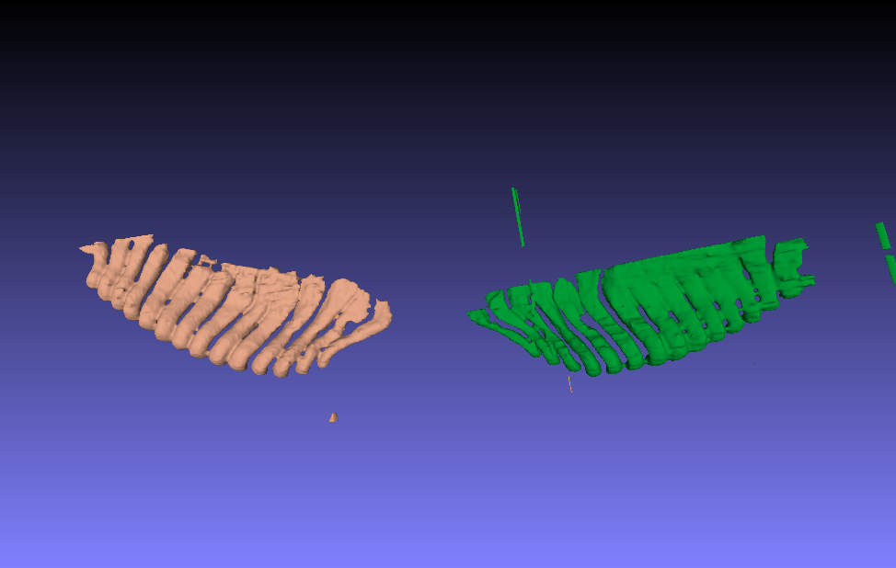

Slide 4
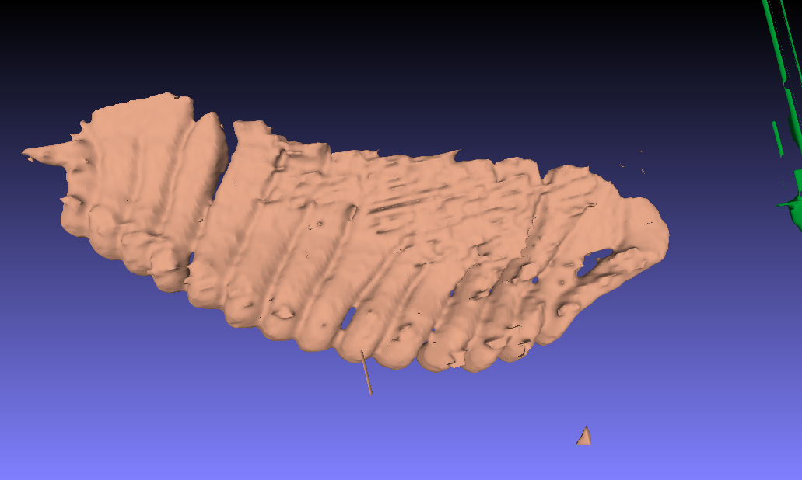

Slide 5
Cholesterol Project: Cnemaspis Mysorensis
worked with one of the PhD students in the lab, Kabir
he taught me how to catch, house and release these geckos.
how to swab and take chemical secretion samples from the lizards.
He had previously done secretion analysis for these geckos and he had found cholesterol to be a large component.
We created a project plan for me to test the geckos to see if they are responsive to cholesterol. I spent the next 6 weeks catching specimen and testing them each day.

Slide 6
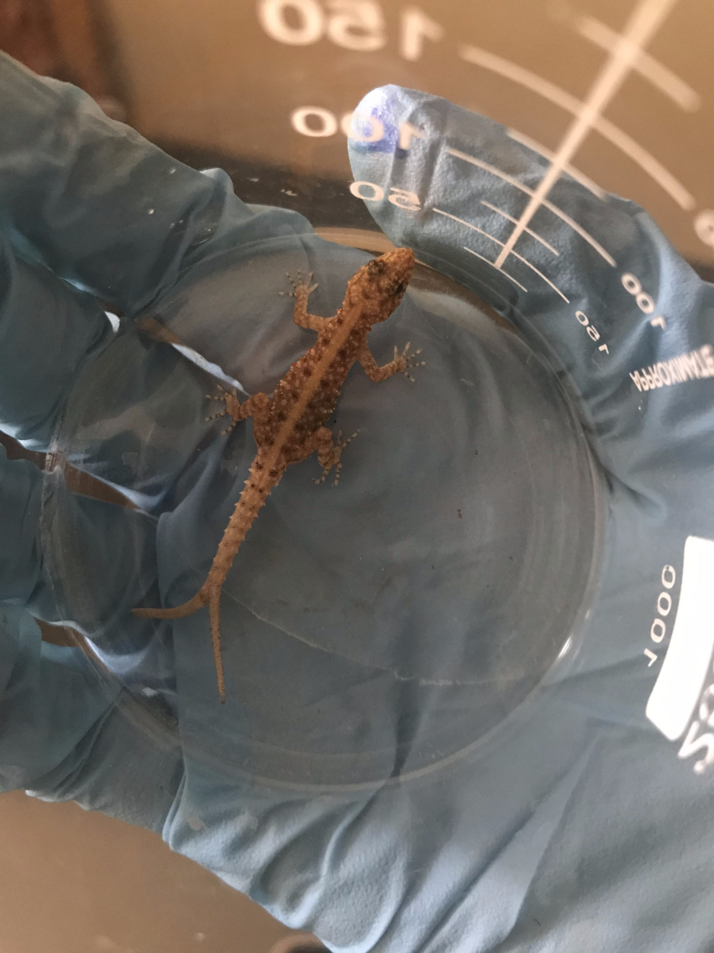
Cholesterol Project
I presented each gecko samples of water, Cholesterol dissolved in DCM and also DCM alone.
how many times it tongue flicked
latency to tongue flicking
how many movement bouts they did
the latency to the first movement bout.

Slide 7
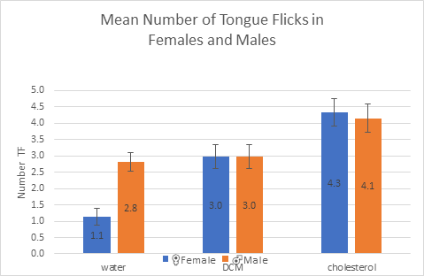
Cholesterol Project

Slide 8
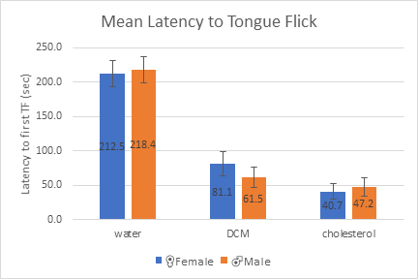
Cholesterol Project

Slide 9
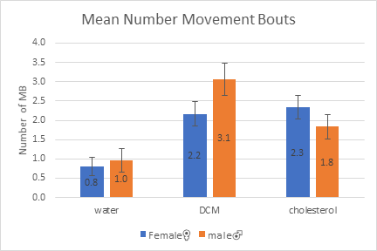
Cholesterol Project

Slide 10
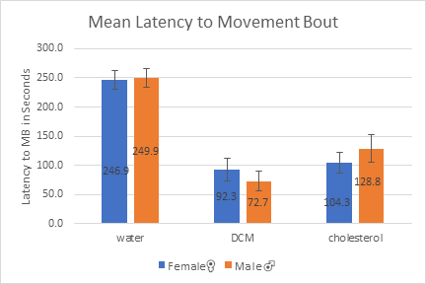
Cholesterol Project

Slide 11
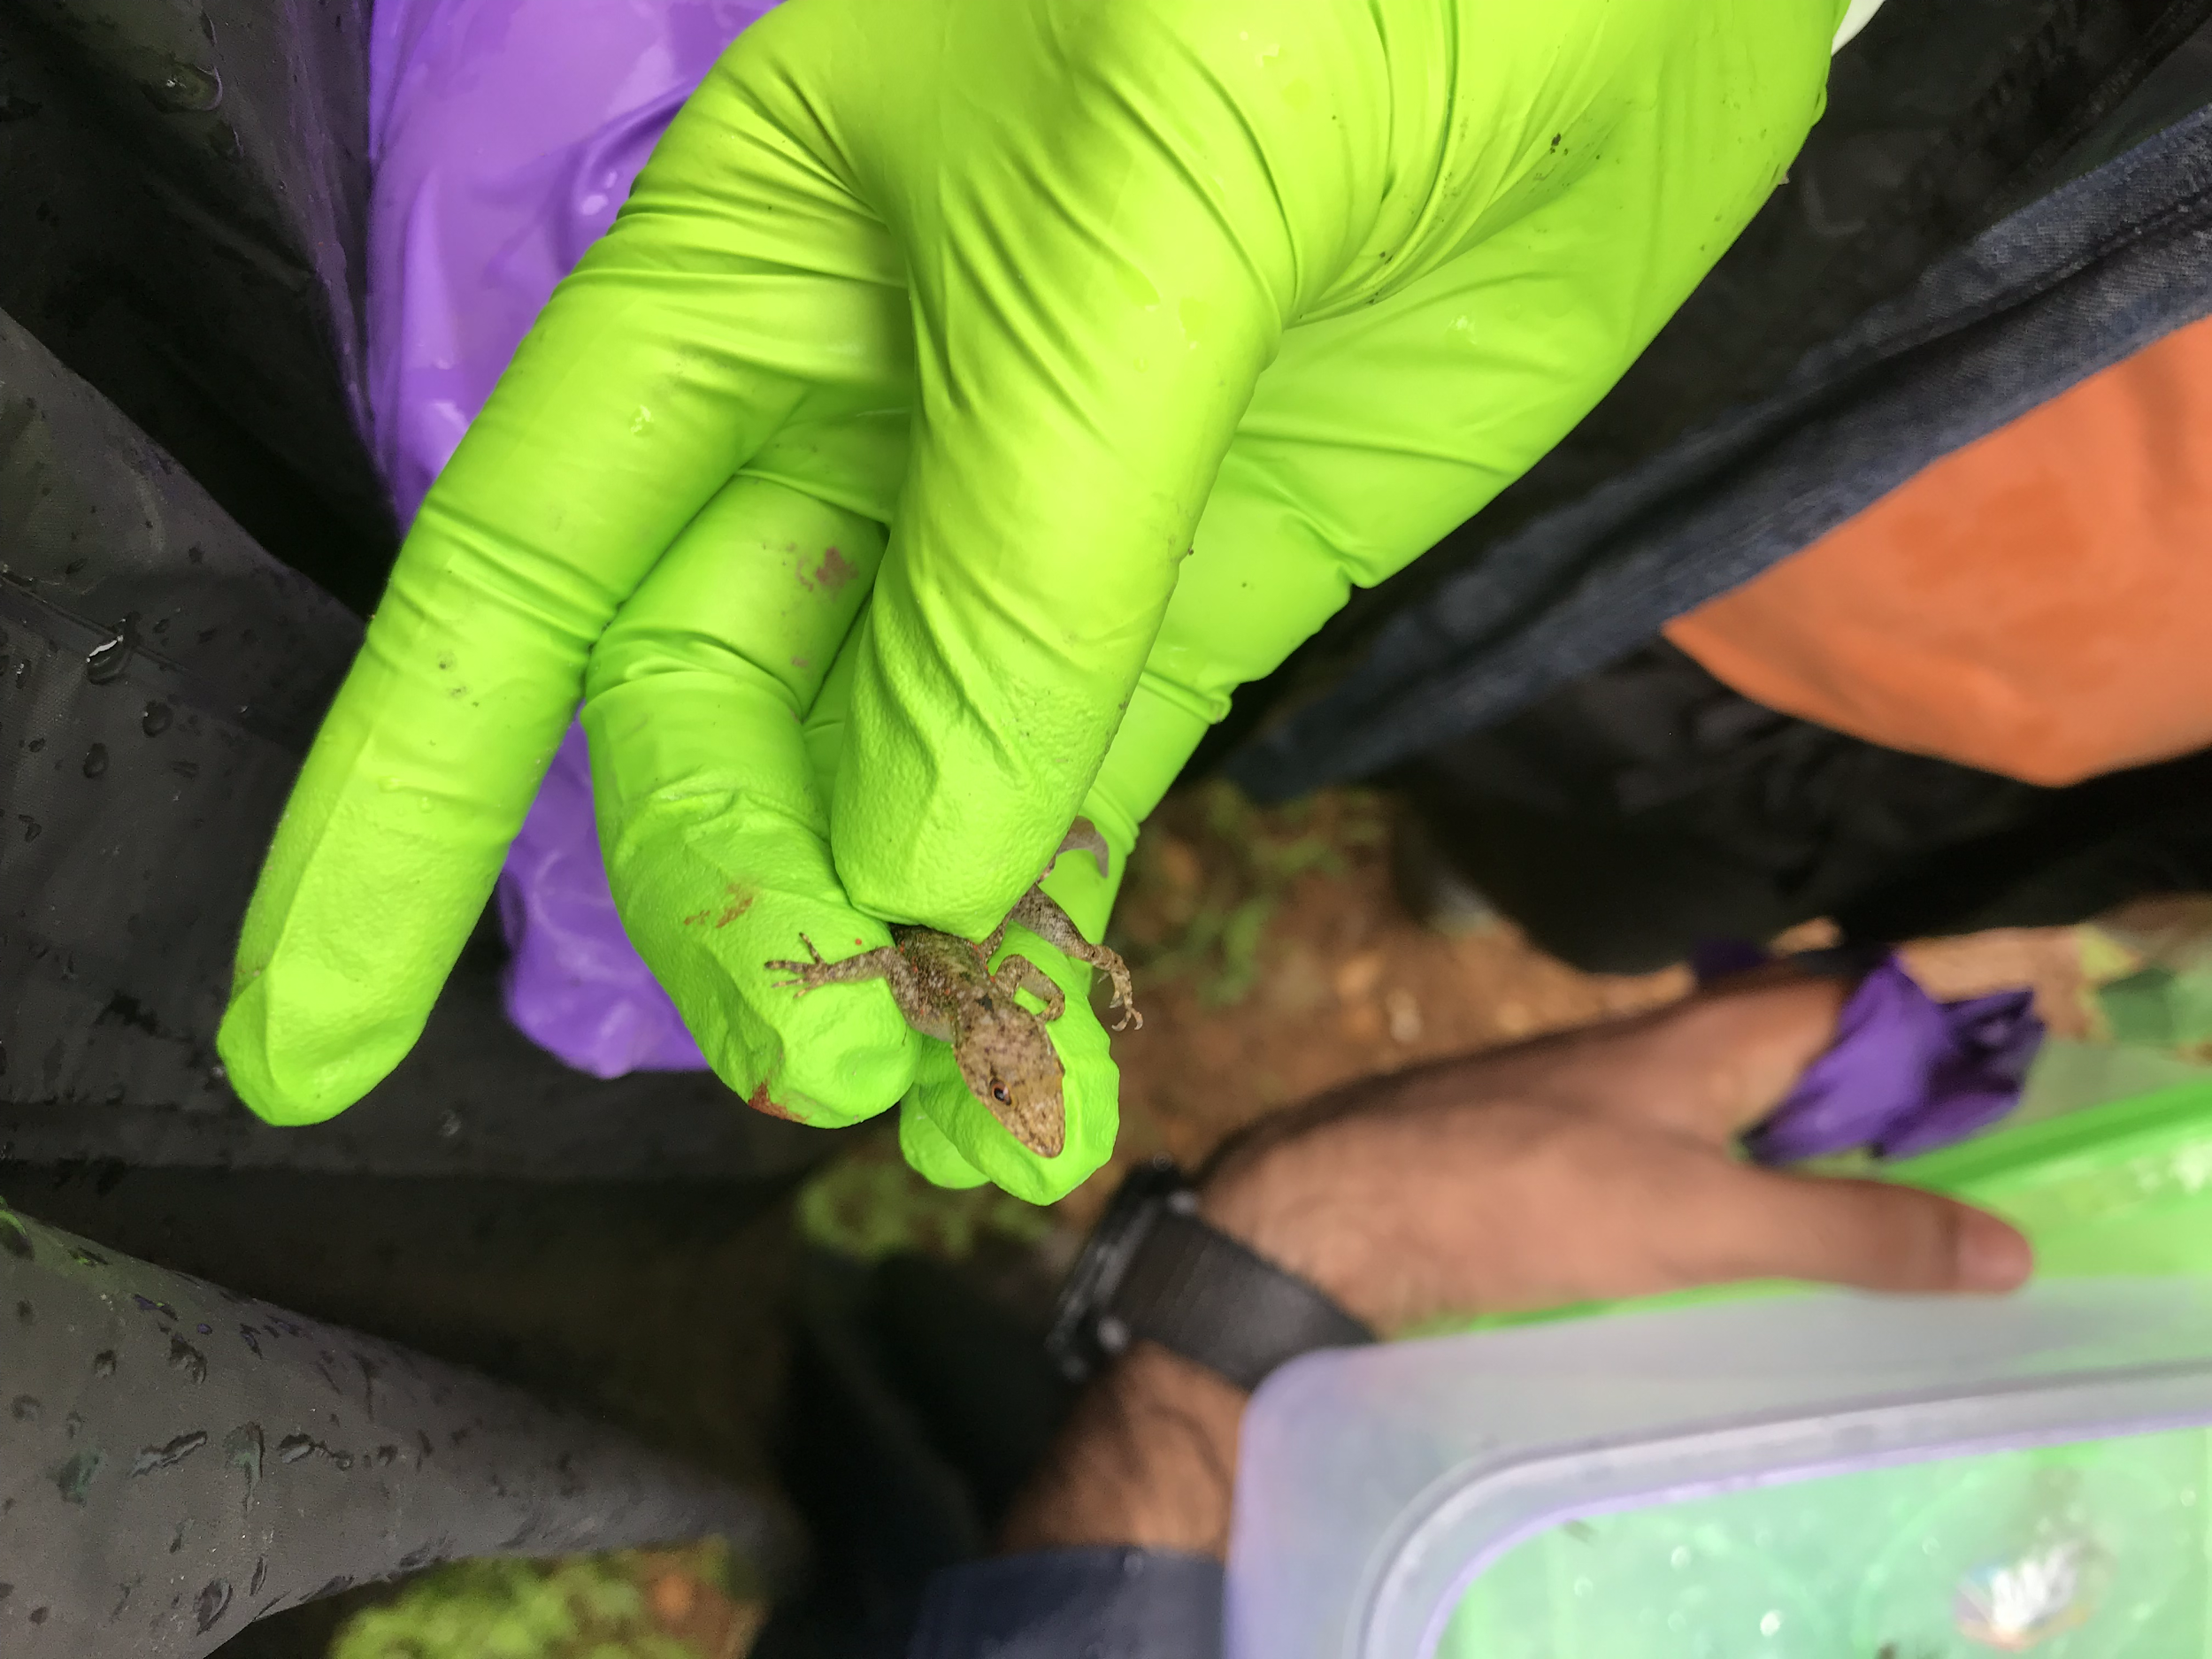
Field Work

Slide 12
